Slide 1

Welcome
Acknowledgement of Country
I wish to acknowledge the people of the Kulin Nation, the custodians of the land we are gathered on today and pay our respects to their Elders, past and present.
I acknowledge that we are meeting on land that was never ceded and that the vast over representation of First Nations people amongst those experiencing homelessness is a direct and ongoing consequence of colonisation.
Always was, always will be Aboriginal land.
Notes:
Sarah
Acknowledgement of country – there is a new piece of data that identifies that, if non Aboriginal people were homeless at the same rate as First Nations people, we would have 1M people homeless in Australia.
Introduce ourselves and our roles
We have representation from such a wide group of workers. Can you introduce yourself and the service you are from in the chat.
Feel free to ask questions at any point. If you don’t feel comfortable asking, put a question in the chat and we will keep an eye on it.

Slide 2
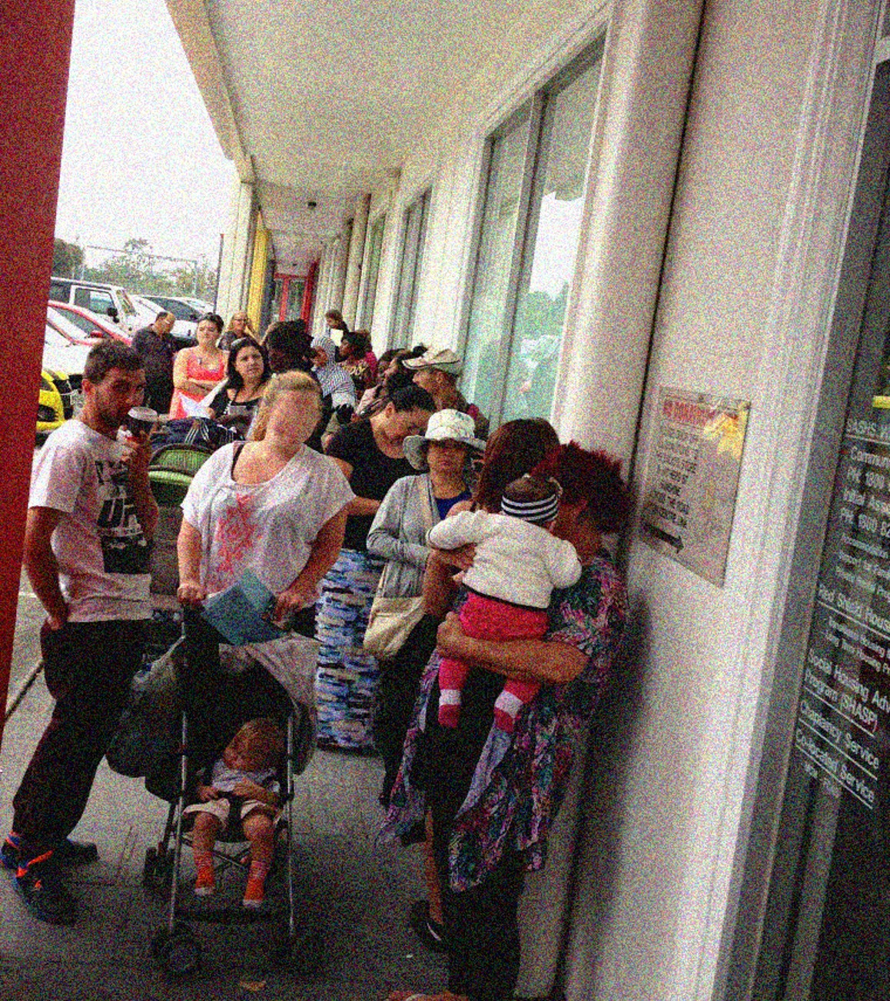
Acknowledgement of those with lived and living experience of homelessness
I would also like to acknowledge those with lived and living experience of homelessness and/or family violence and recognise their strength, resilience and courage.
They are suffering the consequences of a structural problem that no-one should be facing in a country as wealthy as Australia.
Notes:
Sarah
Acknowledgement of country – there is a new piece of data that identifies that, if non Aboriginal people were homeless at the same rate as First Nations people, we would have 1M people homeless in Australia.
Introduce ourselves and our roles
We have representation from such a wide group of workers. Can you introduce yourself and the service you are from in the chat.
Feel free to ask questions at any point. If you don’t feel comfortable asking, put a question in the chat and we will keep an eye on it.

Slide 3

The Homelessness Service System in Melbourne’s west
December 2024
Notes:
Sarah

Slide 4

Orientation
Overview of homelessness in Melbourne’s west
Those assisted by the Homelessness Service System (HSS)
Role, resources and navigating the HSS
Supporting children
Framework for the homelessness service system
Long term housing
Advocacy
Contacts and resources
Notes:
Sarah
We hope that this will be a very informal session.
Please ask questions – jump in at any point. The session is far more interesting if we can have some discussion.
We will have a break in the middle of the session but can also have two shorter breaks, if you prefer.

Slide 5
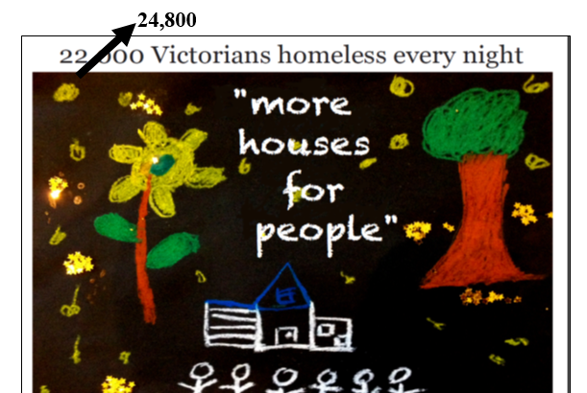
Overview of homelessness in Melbourne’s west
30,605
Notes:
Sarah
We will first look at the extent of homelessness in the West.

Slide 6
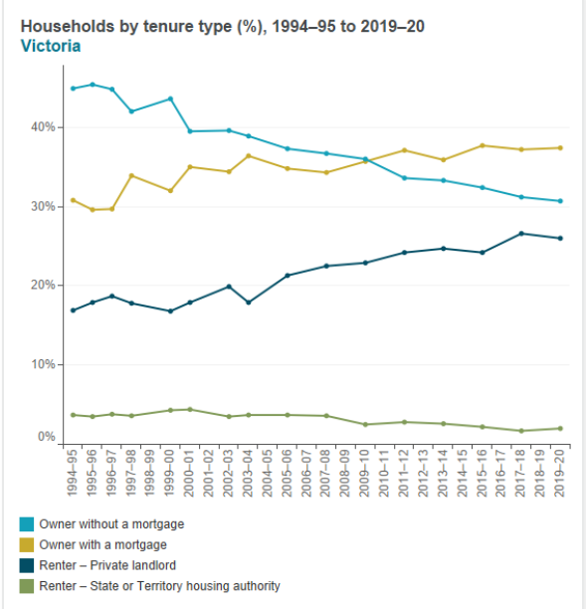
Households by tenure type in Victoria:
1994/95 – 2019/20
Notes:
Sarah
Source: AIHW Home Ownership and Housing Tenure Report, March 2023
This chart shows the type of housing arrangements that most people are in: it’s roughly 30% outright home owners; 30% owners with a mortgage and 30% renting, with a tiny proportion in social housing.
The proportion of young people who are home owners is much smaller than the proportion of young people have been home owners in the past.
Rates of home ownership for Indigenous Australians were consistently around 20 percentage points lower than home ownership rates for non-Indigenous Australians across all birth cohorts and age groups.
The number of older people who go into retirement with a mortgage is increasing.

Slide 7
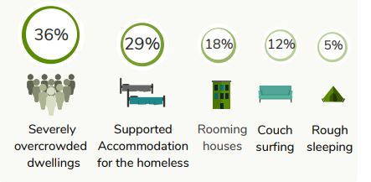
Rough sleeping is the tip of the iceberg
Census 2021: 30,605 Victorians were experiencing homelessness.
People sleeping on the streets are the tip of the iceberg in terms of the real numbers of people experiencing homelessness.
Nearly 1/5 of those experiencing homelessness in Victoria identify as being in Melbourne’s west.
The numbers of people experiencing homelessness in the West increased by 40% from 2011 to 2016 but remained the same for 2021 (Census was impeded by lockdown).
The number of people living in severe overcrowding (4 or more bedrooms short) increased by 60% over the past 10 years.
Notes:
Sarah
We begin with a lot of statistics – to set the context and to identify the systemic issues.
One of the most significant issues we have in the West is severe overcrowding – people living in houses that are 4 or more bedrooms short – even if children of the same gender share a bedroom.

Slide 8
Notes:
The 2021 Census Homelessness Enumeration figures show a rise in the number of people identifying as homeless in Victoria to 30,605 people. Nearly 20% of those who identified as homeless on Census night are in the West.
The figures for the West are almost identical to the figures for the West in 2015, showing an increase of only six people. Both the Southern and Eastern Metropolitan Regions reported increases of over 1,000 people each.
The highest levels of homelessness in Melbourne’s west were reported in Brimbank, followed by Wyndham and then Melbourne. (Large numbers of people were accommodated in hotels in the City of Melbourne as we were in lockdown on Census night.
Almost as many people in Melbourne’s west reported living in over crowded situations (not classed as severe over crowding) as reported experiencing homelessness on Census night in the West.
915 people reported living in boarding/rooming houses in the West on Census night. This has nearly doubled in the last 10 years, with the highest numbers reported in Maribyrnong and Brimbank.
Brimbank and Melbourne are the areas in which the highest number of people reported sleeping rough. 191 people across the West were identified as sleeping rough, despite the fact that Melbourne was in lockdown at the time of the Census.
Brimbank reports the third highest levels of severe overcrowding by LGA in Victoria and Brimbank, Wyndham, Melton and Maribyrnong (in that order) all fall within the 10 LGAs reporting the highest levels of severe overcrowding (a property that is four or more bedrooms short, even accounting for gender).
Maribyrnong reports the highest rate of homelessness per 1,000 of population.

Slide 9
Why is homelessness increasing?
Melbourne needs 2.3 M more houses by 2051. Insufficient housing supply leads to an increase in the cost of housing.
Private rental properties rates are extremely low (1.1 % in Jan 24) and rents have risen 19% in the last year.
Why is homelessness increasing?
We have a crisis in housing supply
There are 13,853 social housing properties in Melbourne’s west and 30,372 households waiting.
Notes:
Sarah
We are experiencing a housing crisis in Melbourne.
Melbourne’s population grew by nearly 1 million people in the 10 years from 2006 to 2016. Supply of housing is not keeping up with this growth. Consequently, Melbourne will need 2.3M more properties by 2050.
Cost of purchasing and renting properties has increased significantly over the past decades. This impacts on the cost of housing.
We also have an insufficient number of houses available for the population (although Census 2021 shows 11% of properties in Victoria are vacant – so we advocate for a vacancy tax). A lack of available housing pushes prices up – both in the purchase and rental market. People who would previously have purchased a home now have to rent and are in competition for the limited rental properties with people on a lower income.
The rental vacancy rate has been at its lowest for years over the past 12 months and, during that time, rents have gone up 15%.
In the 90% 7% of properties were social housing. Now it is 2.8% in Victoria – lower than any other State.

Slide 10
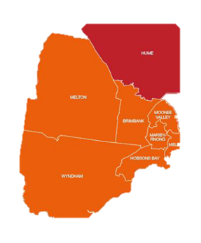
Melton
Est need for 4,100 social housing properties
70% of Q1 in rental stress
24% of homes rented
Average cost of a home risen from 2.3 to 6.1x median annual wage
Housing and homelessness by LGA
Moonee Valley
Est need for 2,300 social housing properties
54% of Q1 in rental stress
33% of homes rented
Average cost of a home risen from 4.5 to 11.9 x median annual wage
Melbourne
Est need for 5,800 social housing properties
53% of Q1 in rental stress
69% of homes rented
Average cost of a home risen from 4.7 to 15.5 x median annual wage
Melbourne’s west
Brimbank
2nd highest levels of homelessness – Census
77% of Q1 in rental stress
Est need for 4,800 social housing properties
28% of homes rented
Average cost of a home risen from 3.1 to 9.1x median annual wage
Maribyrnong
Est need for 2,000 social housing properties
61% of Q1 in rental stress
44% of homes rented
Average cost of a home risen from 4.2 to 10 x median annual wage
Melton
Moonee Valley
Brimbank
Maribyr-
nong
Melbourne
Hobsons Bay
Wyndham
Est need for 7,000 social housing properties
73% Q1 in rental; stress
32% of homes rented
Average cost of a home risen from 2.5 to 5.9 x median annual wage
Wyndham
Hobsons Bay
Est need for 1,900 social housing properties
61% Q1 in rental stress
30% of homes rented
Average cost of a home risen from 3.6 to 9.8 x median annual wage
Notes:
Sarah
Many of those in housing are in precarious housing.
High numbers of people in mortgage and rental stress
Areas like Wyndham Vale and Melton area still growing.

Slide 11
Why is homelessness increasing?
In March 2024 Anglicare reviewed the 9,852 properties available private rental properties in Melbourne
There were 3 properties affordable for a couple on Centrelink payments with one or two children and 1 property in the whole of Melbourne affordable for a single parent with 1-2 children on Parenting Payment.
Why is homelessness increasing?
We have an affordability problem
There was not a single property affordable for a single person on Jobseeker or a young person on Youth Allowance.
Notes:
Sarah
A second contributing factor to homelessness in Victoria is that we have an affordability problem. Purchasing housing has never been more expensive. Some decades ago, it cost the average of two years income to purchase a house. It now costs at least ten years of an average income.
Similarly, when the rental market is tight, rents increase, creating fewer and fewer affordable properties.

Slide 12
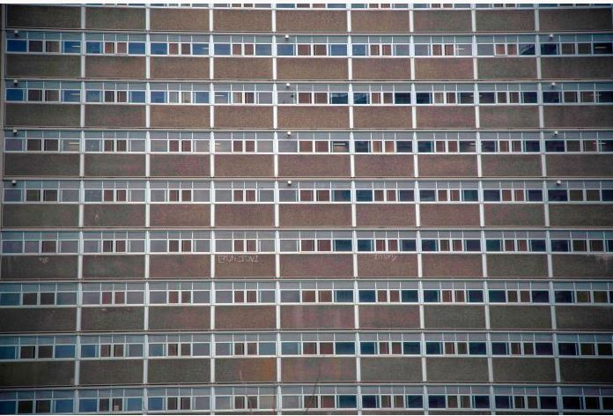
Inadequate social housing supply
60,000 households on the social housing waiting list now. (This is more than 82,000 Victorians, including over 25,000 children).
Approximately 3,500 households are allocated social housing each year.
There is at least a 3 year wait for urgent applicants and indefinite waits for other groups.
The State Government Big Housing Build is constructing 9,300 new social housing properties over 4 years.
However, just to meet the national average Victoria will need to build more than 6,000 properties each year for ten years.
Victoria has the lowest proportion of social housing of any State.
Notes:
Sarah
When people cannot afford to purchase their own home, or to rent, the only remaining permanent housing option is social housing, yet Australia has very low levels of social housing, comparatively, and Victoria has the lowest levels in Australia.
We have received some good news recently, in terms of State and Federal investment in social housing but this equates to housing levels to meet less than 13% of those waiting for social housing in Victoria.

Slide 13
30,605
Those assisted by the homelessness service system
Notes:
Amy

Slide 14
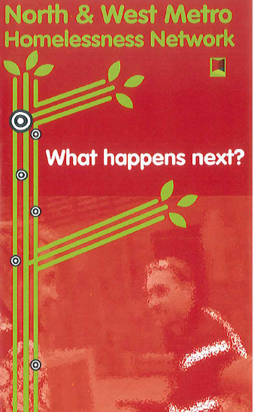
Role of Consumers in the service system
All programs are voluntary
Consumers choose geographic area and programs
Consumer charter guides client rights and responsibilities
Consumers consent to transfer of information across the homelessness system
Consumers can identify if there are services that they don’t want to be referred to
Network collects and responds to consumer feedback.
Notes:
Amy
Engagement with homelessness services is voluntary.
Consumers are asked for their consent to transfer information across homelessness services. This consent last six months. Consumers can identify if there are any services that they don’t wish to receive their information.
Importantly, consumers can choose the geographic area in which they would like to be assisted. Services are funded to work within a specific area, but not just to work with consumers from that area.
Every year in September the LASNs survey consumers about their experience of the homelessness service system.
Each homelessness worker is asked to find one consumer who is prepared to participate in the survey.

Slide 15

Who is seeking homelessness assistance and why?
Of those who present to the HSS in Victoria, generally
    60% are women
    17% are under 25 (12% in the West)
    36% are sole person households
    43% are accompanied by children
    13% are First Nations people (8% in the West)
Research shows that generally one event will trigger homelessness.
People presenting to homelessness service identify the key trigger as:
    Financial difficulties (48%)
    Family violence (40%)
    Housing crisis (36%)
  Other key triggers are:
    Abuse and family breakdown (young people)
    Loss of employment
    Ill health
Notes:
Amy
First Nations people present to homelessness services at double their proportion of the general population.
The numbers of young people presenting alone have been dropping over the last years.
People are reporting financial difficulties as their main reason for accessing homelessness services at a higher rate – family violence was the main reason people accessed homelessness services for many years – this could be the result of data collection changing as The Orange Doors have rolled out, but could also reflect the impact of the cost of living crisis.

Slide 16

Impact of being without a stable home
Women experiencing homelessness reported:
deterioration in their mental health
worry about their children
family breakdown
being raped whilst homeless
being scared, unsafe, despairing, and
loneliness.
Men reported:
  deterioration in their mental health
  depression
  Anxiety
  inability to work, and
  loss of employment.
Notes:
Amy
Every year homelessness services ask consumers about their experiences of homelessness and the homelessness service system.
Women report:
deterioration in their mental health
worry about their children
family breakdown
being raped whilst homeless
being scared, unsafe, despairing, and
loneliness.
Men report:
deterioration in their mental health
depression
anxiety
inability to work, and
loss of employment.
There are some case studies on our website about the changes that happen for people when they do manage to get some stable housing.
Most consumers have become homeless as a result of trauma but also experience terrible trauma as a result of the experience of being homeless. As a Sector, we need to be responsive to trauma.
What would life be like if you lost your home?

Slide 17
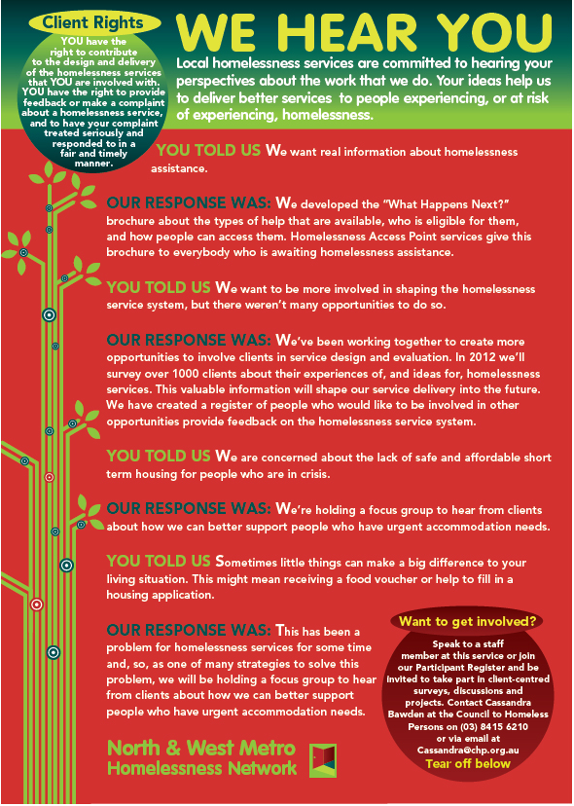
Feedback from Consumers
The experience of homelessness is devastating
Melbourne is experiencing a housing crisis – the key thing that consumers identify would improve their experience of the homelessness service system is access to affordable housing.
Consumers generally feel respected by homelessness service providers.
Consumers report that they still have to tell their story more often than they would like.
Emergency accommodation is generally inappropriate and harmful.
Consumers report a key reason for seeking support is “someone to talk to about my problems”.
Consumers express different preferences for communication methods: face to face, phone, zoom, whats app
Consumers want accurate and transparent information.
Notes:
Sarah
In 2019 the survey focussed on consumers’ experiences of homelessness and asked what they would like us to advocate for in the State and Federal elections.
In 2021 the survey focussed on consumer experiences of the new ways of working that we moved to during the pandemic.
The 2022 survey focussed on consumers’ experiences of emergency accommodation.
Key learnings:
Importance of building on information from other services – read the IAP and build on it. Don’t ask a whole lot of questions that have already been asked
‘Someone to talk to about my problems’ – even when we can’t meet people’s needs for housing, we can still listen, sympathise

Slide 18
Navigating the HSS in Melbourne’s west
30,605
Notes:
Amy
We will now move on to information about:
The role and resources of the homelessness system; and
How to navigate the homelessness system in the West.

Slide 19
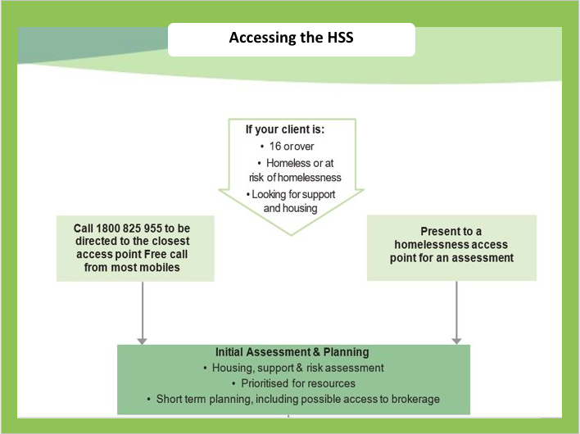
Accessing the HSS
Notes:
Marcella/Amy
Eligibility for homelessness services is very straight forward. Anyone can access the homelessness system if they are:
16 or over (by law, those under 16 who are unaccompanied should be assisted by Child Protection)
Homeless or at risk of homelessness; and
Looking for support and housing.
Consumers can either call or present to the access/entry point in the area in which they wish to be assisted.
If consumers don’t know how to find an access point, or they need assistance after hours, they can contact the state-wide number: 1800 825 955.
Access points can also forward consumer information between them.
Technically people don’t need to have residency or an income to access homelessness services, but services are limited in their capacity to support people with no income.

Slide 20
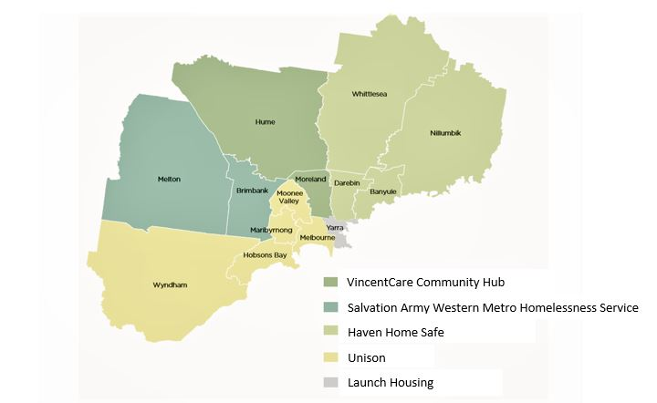
Access point catchments
Unison | 9689 2777 iap@unison.org.au | 112 – 122 Victoria St Seddon
Unison outpost | 9216 0300 iapwerribee@unison.org.au | Level 1, 1-3 Watton St Werribee
Salvation Army Western Metro Homelessness Services | 9313 4700 sunshineIAP@salvationarmy.org.au | 34 Devonshire Rd Sunshine | Initial contact is generally by phone. Service will be moving – July? Melton outpost is currently closed.
Unison Werribee outpost
iap@unison.org.au
7 Cottrell St, Werribee
Notes:
Amy
In 2008 the Homelessness Service System was restructured to develop a ‘front end’ – access/entry points – that operate like a triage to the broader homelessness system. This change was made following consumer feedback that the homelessness system which, at the time had 400 points of access, was confusing to navigate.
Unfortunately, little additional funding was provided to create access points, so there are not many of them.
There are two access points in Melbourne’s west: The Salvation Army Western Metro Homelessness Service and Unison. Each access point has a main office and an outpost.
Young people also have access to Frontyard, in the city, and women can also access Women’s Housing Ltd, a small, phone based statewide access point.
People with disabilities can also contact Housing Choices.

Slide 21
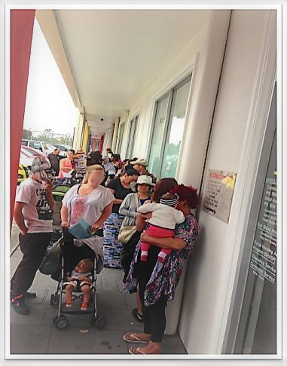
Access
Access points in the West are Salvation Army Western Metro (Brimbank/Melton), with a youth specialist response and Unison (rest of the west)
Women’s Housing Ltd, Frontyard and Housing Choices are specialist access points. Some access points have appointments
ADDRESS ON HEALTH CARE CARD OR WHERE SOMEONE’S CAR IS PARKED DO NOT DETERMINE SERVICE.
First contact generally by phone (ring 9-5)
1800# - can forward a call to the nearest access point during the day if the consumer knows their postcode
Access Points negotiated a shared approach to HEF allocation.
After hours – St Kilda Crisis Centre responds via 1800#
Notes:
Amy
Appointments are generally being made via phone in the first instance. (This photo shows the line of people waiting before 9am at an access point, before the phone appointment system was developed.)
It is very important to note that address on health care card does not determine where a person can be assisted. People can present to any access point.
This does not mean that they will necessarily get a service as more people present to access points than the number of available appointments.
The Access Points manage demand differently. Some work on appointments, but keep capacity for emergencies
The number of appointments is determined by IA&P teams’ availability.

Slide 22

Access point - Initial assessment & planning (IAP)
Ascertain
Ascertain need for emergency accom
Co-contribution system
Identify
Identify short term goals and develop a plan in response
Undertake
Undertake a risk assessment
Place on
Place on prioritisation list for referral to support and accommodation
Make
Make referrals if possible (PRAP, support)
HEF, referral to hotels and rooming houses
Notes:
Amy
The role of access points is to:
assess someone’s need
provide information about options
help them address immediate risks (including trying to source short term accommodation)
develop a short term plan
make referrals to relevant services, if possible; and
place people on a prioritisation list if they are awaiting homelessness support.

Slide 23
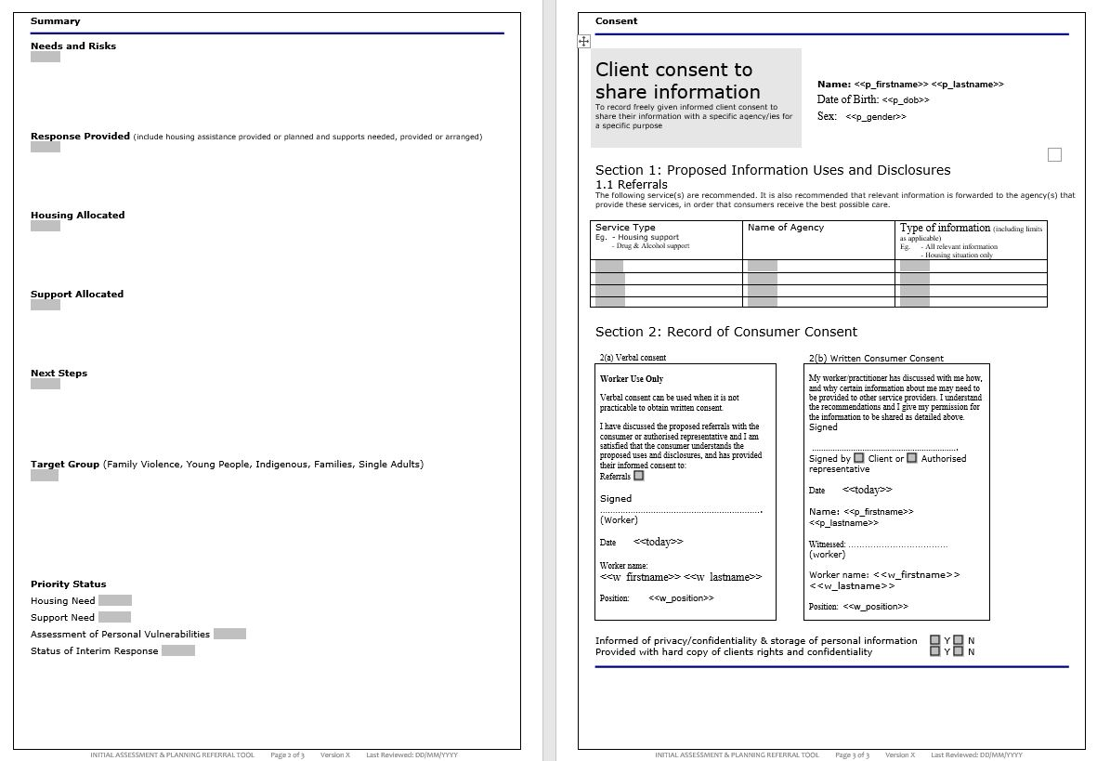
Statewide IAP assessment tool
Notes:
Sarah
Access point services use a standard assessment tool.
Generally, this tool is completed by an Initial Assessment and Planning worker at an access point (called IAP workers and the IAP tool ). Some access point services will accept IAP forms from other services.

Slide 24
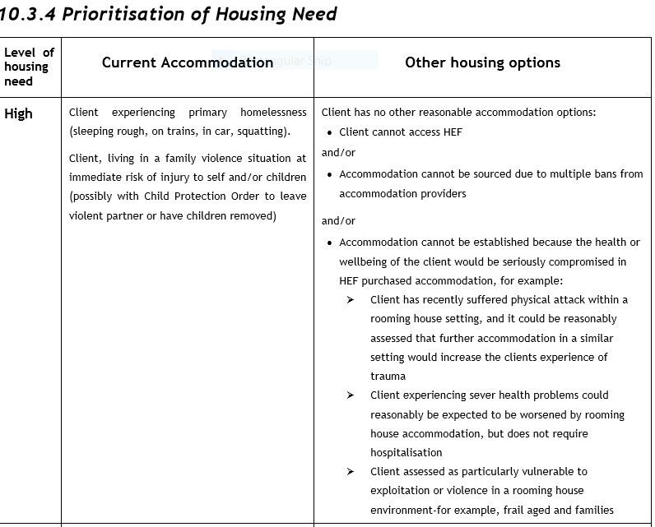
Housing need
Notes:
Sarah
Consumer need is assessed in relation to three things: housing, support and vulnerability. Consumers are assessed as having a high, medium or low level of need according to a standard set of definitions.
It is part of the access point role to assess peoples need according to the shared matrix.
This is important because, when support services identify that they have a vacancy, they use the same matrix to identify if the support vacancy is for someone with a high, medium or low level of need.

Slide 25
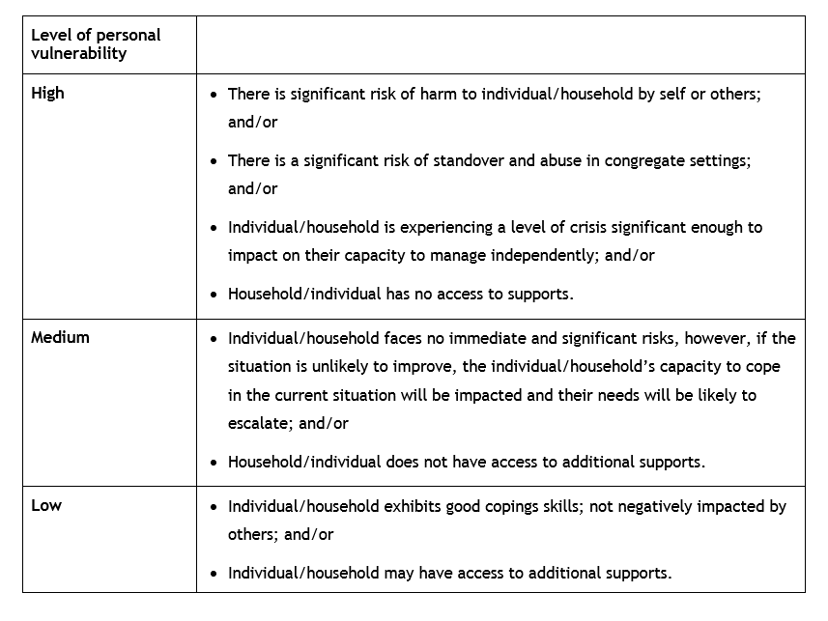
Level of vulnerability
Notes:
Sarah

Slide 26
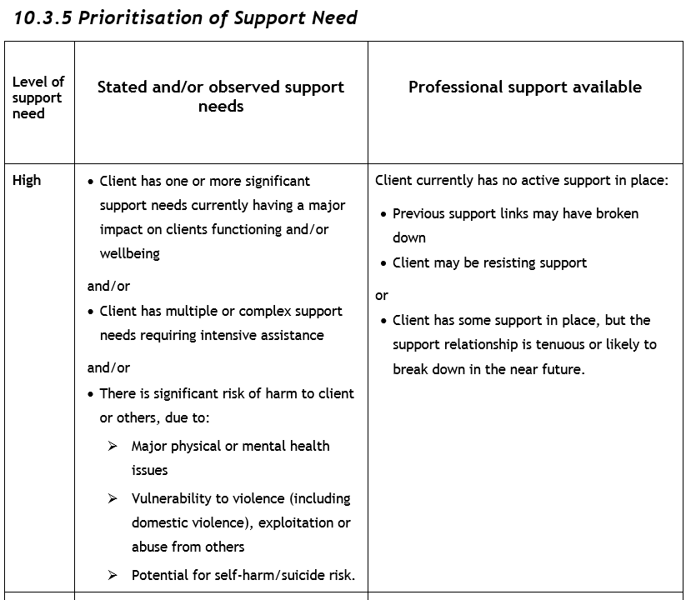
Support need
Notes:
Sarah

Slide 27
Purchased accommodation
If people have nowhere to live, access points will try to purchase emergency accommodation for short periods.
Funding is now so tight that services prioritise funding for emergency accommodation.
There is not enough funding to accommodate everyone who needs it for as long as they need it.
MOTELS/HOTELS
Motel accommodation consists of basic living facilities. Motels with cooking facilities are rare and expensive
2 rooms are required for large single parent families
During lockdowns Homes Victoria provided more HEF so that people experiencing homelessness could be accommodated in hotels
Families are generally asked to co-contribute 30% of incomes to stretch their stay for
ROOMING HOUSES
The majority of rooming houses are unhabitable; unregistered and unsafe, therefore, not used by the Salvation Army
Housing agencies are boycotting some of the most unsafe and unregistered rooming houses.
Notes:
Amy
There is not enough funding to accommodate everyone who needs it for as long as they need it. Funding is now so tight that services prioritise funding for emergency accommodation. Funding is currently prioritised for families and then young people. There is almost no funding for single people.
Generally the accommodation accessed is very low end because:
The cheaper the accommodation, the more people can be accommodated; and
Many providers will not take referrals from homelessness services.
We know that this accommodation is often harmful to consumers and that it is in no way appropriate for their needs.
Families are often asked to co-contribute to their stay, to stretch their accommodation longer.

Slide 28
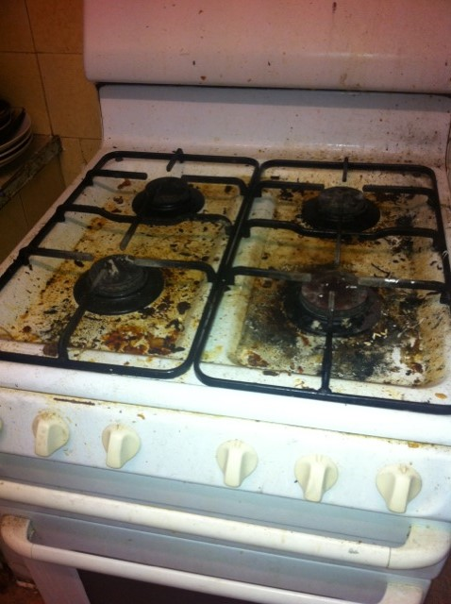
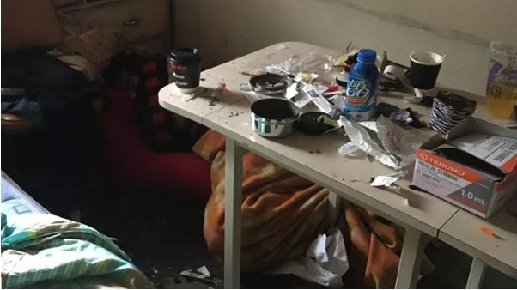
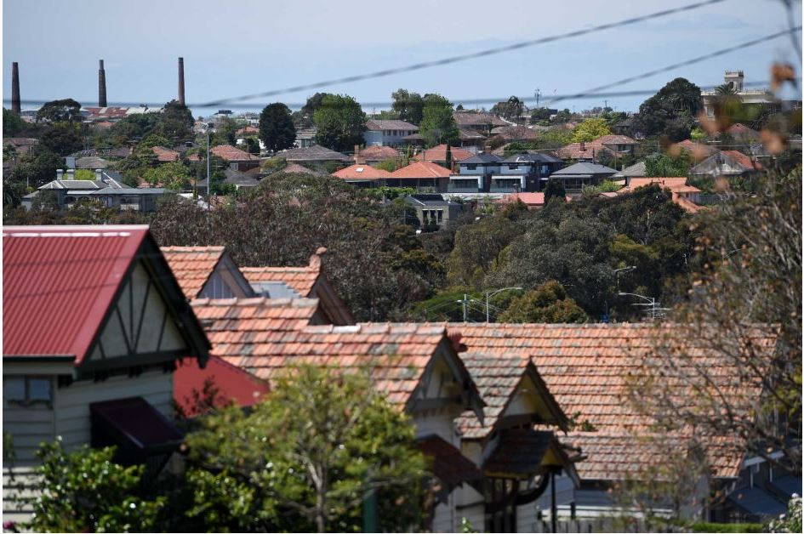
A Crisis in Crisis
There are 423 government funded crisis beds in Victoria.
When these beds are full, homelessness services purchase hotel and rooming house accommodation.
The homelessness access points in Melbourne’s north and west had to purchase nearly 10,000 beds in 2018/19.
During the pandemic over 3,000 households were accommodated in hotels – largely with poor amenity.
Sector has developed a ‘script’ for consumers.
For more information on crisis accommodation, see “A Crisis in Crisis” Crisis in Crisis: The Appalling State of Emergency Accommodation in Melbourne's north and west (nwhn.net.au)
Notes:
Sarah
When people present to the homelessness system because they don’t have anywhere to live, we have limited access to supported accommodation. However, there are 423 crisis accommodation beds in Victoria. In one year alone, services just in Melbourne’s north and west, had to find 10,000 beds.
There is limited money to purchase short stays for people in hotels and motels. This money is so limited that we have to use very low-end hotels, we can’t purchase rooms for everyone who needs them, we can’t purchase them for as long as people need them, and consumers have to contribute to the costs.
During the pandemic, additional funds were obtainable to purchase accommodation – but it was still not enough. Thousands of people were positioned into hotels during the pandemic, but we can’t find housing exit options for most of them, so many are returning to homelessness.
The Homelessness Services have written a report about the appalling lack of appropriate crisis accommodation. You can find the link on the slide. When we launched the report the Department of Families, Fairness and Housing provided funding for 2 project workers to expand on this report. We then released a second report – Crisis in Crisis II.

Slide 29
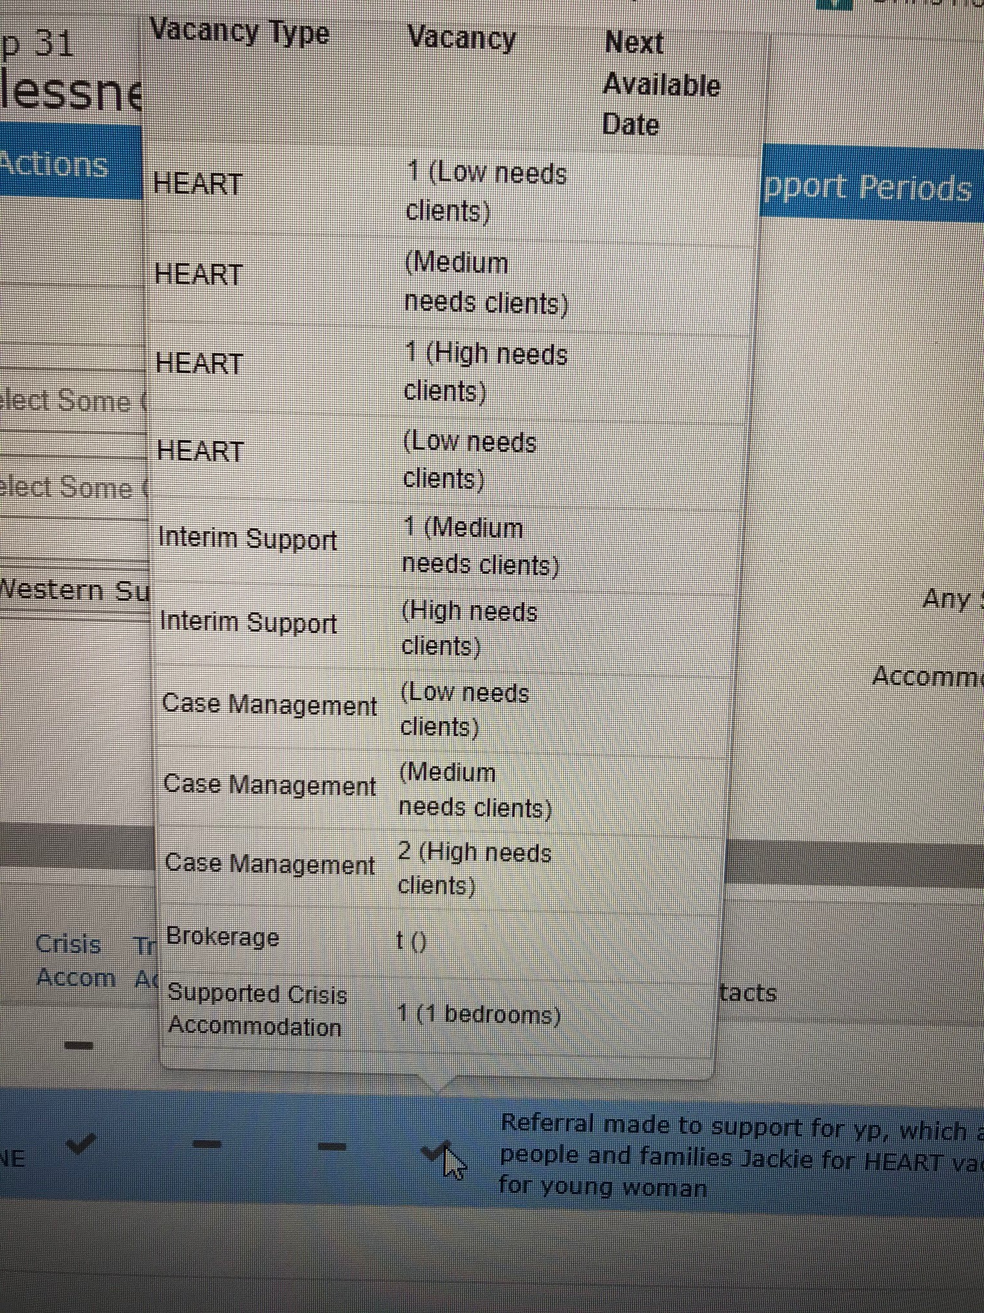
Vacancy Management System
In SHIP and SRS
Available to non SHIP homelessness services
Services with vacancies load vacancies
Vacancies show type and complexity of support available
Refuge vacancies included
Notes:
Sarah
The Vacancy Management System can be found in SHIP. Services using SAMIS and SRS have access to the VMS, separate from SHIP.
All homelessness services should be recording vacancies in the VMS. The access points then check for vacancies and match those waiting with the services available.

Slide 30
Resource Allocation
All resources listed on VMS
Holder of resource responsible for ‘publishing’ and describing resource
Access Points ‘best matches’ to available resources from prioritisation list
Resources are allocated:
To those in greatest need
Matched to available resources
For those who have been waiting longest
Access Point usually contacts the consumer to check that they would like to be referred to resource​
Access Points refers to resource (support first, then housing if available)​
NB:
E referral is available in SHIP/SAMIS to assist with sharing of information​
Consumers report they are still telling their stories too often – importance of reading referral
Notes:
30
Sarah
Access Points ‘best match’ to available resources by filtering the prioritisation list
If a number of consumers are in the same level of need, the access point refers consumer who has been waiting longest
Access point contacts consumer to advise of possible referral
Consumers are referred to support resources first.
If the support services determines that transitional housing if the best housing option, consumer remains on the prioritisation list.

Slide 31
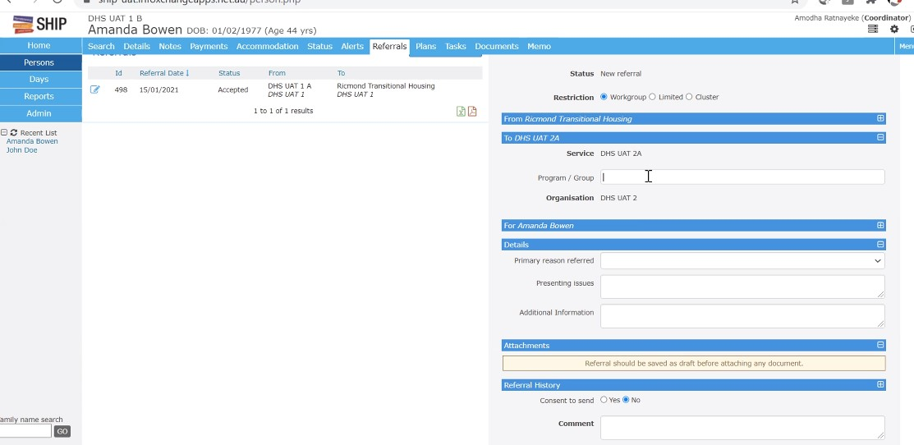
E referral
E-referral assists us to work as a service system, so consumers don’t ‘tell their story too often.’
All homelessness services have the capacity to send referrals to each other electronically through SHIP/SAMIS.
This is safer than emailing referrals.
SHIP keeps a record of referrals sent and received.
E referral sets up a support period and migrates information to SHIP
Link to e-referral training
Overview session - https://bit.ly/eReferral-Overview
Demonstration session - https://bit.ly/eReferral-Demonstration
Info sheet: Data and SHIP/data tools (nwhn.net.au)

Slide 32
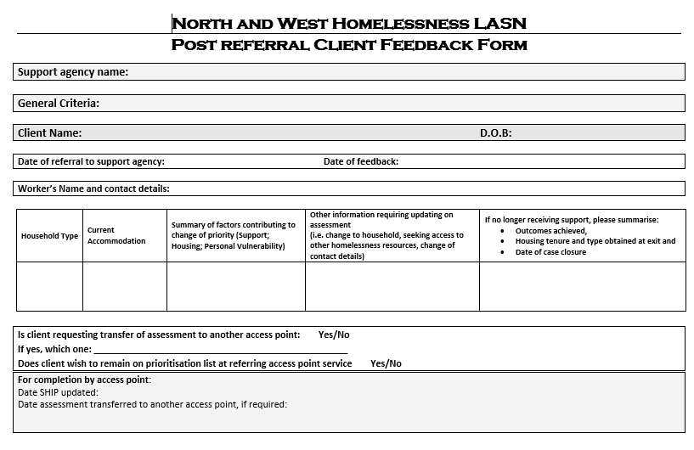
Acceptance of referral
Support agency accepts first eligible referral
Agency contacts client, provides information about the service and arranges a catch up
Support agency commences comprehensive assessment (assessment builds over time)
Support agency advises access point whether consumer needs to remain on prioritisation list for transitional housing or other resources
Support agency can forward updates on this form or through e referral.
Notes:
32
Amy
Access Points ‘best match’ to available resources by filtering the prioritisation list
If a number of consumers are in the same level of need, the access point refers consumer who has been waiting longest
Access point contacts consumer to advise of possible referral
Consumers are referred to support resources first.
If the support services determines that transitional housing if the best housing option, consumer remains on the prioritisation list.

Slide 33
Assessment
Assessment is narrative based
Recorded in a standard format across the State:
Needs & risks; Response provided; Housing allocated; Support allocated; Next steps
Two part assessment:
a) Initial assessment – Undertaken by Access points
  Incorporates risk assessment
  Assessment of support need, housing need and personal vulnerability
  Informs short term planning and matching to service vacancies
b) Comprehensive assessment – Undertaken by Support agencies following a referral
  Comprehensive assessment of range of needs identified by client to inform case plan
  Worker and client have capacity to address needs identified
Notes:
Sarah
Consumers tell us that they are still telling their story too often. One way to address this is to try to work in as coordinated a way as we can.
Assessment within the homelessness system has two parts:
The first is an initial assessment, undertaken at the access point. The aim of that assessment is to identify immediate risks, work with the consumer on a short term plan and to work out what service will most meet their needs.
Most people presenting to an access point won’t be able to access support, so it is important that IAP workers focus on providing information, not on conducting a full assessment.
A more comprehensive assessment is done by a support agency, when they receive a referral. This assessment is more comprehensive because it will shape the support plan - the support worker and consumer will, together, have more capacity to address issues identified through the assessment.

Slide 34
Resources of the Homelessness Service System
Access Points (2+ 1 youth & 1 family violence) | Providing: initial assessment, short term planning, risk assessment, prioritisation and referrals to homelessness services
Crisis supported accommodation | Youth refuges, women’s refuges and Flagstaff/Ozanam/Southbank – average stay of 6 weeks
Transitional housing | 1,100 properties – managed according to the Housing & Support Partnership Agreement
Support | Most homelessness assistance is outreach based, case managed support for an average of 13 weeks
Interim Response 2 and 3/Brief Task Based Response | Support allocated to people for a very short time to undertake discreet tasks that will help someone avoid becoming homeless or will reduce they crisis they are experiencing before they can access support.
Homelessness Emergency Accommodation Response Team (HEART)/H2H | HEART: Coordinated support to people experiencing homelessness who are accommodated in hotels as a COVID response. H2H: medium term housing and support packages for people who were accommodated in hotels during COVID.
Brokerage | HEF, Private Rental Access Program, Family Violence packages
Day centres | Drop-in services, such as VincentCare Homelessness Resource Centre and St Mary’s House of Welcome – providing food and some onsite services
Tenancy Plus | Support to tenants of public and community housing, whose tenancy is at risk.
Children’s programs | Children’s Resource Coordinators, Bright Futures
Specialist programs | Aboriginal Community Controlled Organisations, Wintringham, Justice linked programs
Notes:
Sarah
The Western Homelessness Network includes:
28 community organisations managing approximately 114 programs
Most of these programs provide support and do not have housing attached.
Primarily we provide support services to assist people experiencing homelessness to find housing – we are not a housing system.
Services are funded by target groups: families, single men, single women, young people, family violence, Indigenous and cross target

Slide 35

Client consent and data
SHIP informed consent approach utilised
Access point services ask for client consent to transfer information across the HSS.
DFFH advised that consent wording to clients is: you will share their information as needed, to achieve the client's primary goal. If they do not want you to share their information, then they should not provide it to you.
If the agency has obtained consent has a copy of the consent at the service, then a copy of the consent does not need to be transferred with the referral.
Consumers identify any services that they don’t wish for information to be transferred to
Consent lasts six months
Specialist homelessness information system (SHIP) is a consumer data system (challenging for IA&P)
Salvation Army uses SAMIS and some services use SRS – all report to DFFH through SHIP
Data is our primary tool for advocacy (SHIP and Census)
See SHIP Info sheet for key data
DFFH reporting provided through SHIP data
Notes:
Sarah
Data is one of our key advocacy tools. The data is one way we advocate about the number of people needing homelessness assistance and the issues they are facing.
Part of the data collection is seeking informed consent from a consumer to collect this data. We advise that the data we collect is de-identified and that it is monitored by government.
There is a sheet in your information pack highlighting some important data integrity issues. DFFH uses the data to monitor services and plan policy and program responses.

Slide 36

Key data questions
Reasons for presenting to homelessness service
Encourage a consumer to list all the reasons that have contributed to them being homeless i.e family violence, family breakdown, mental health issues etc.
Revisit these questions
Needed, provided, referred
Key field for identifying complexity of need
List all ‘needs’, whether or not the service can provide them.
List long term housing as a need
Housing situation at beginning and end of support
Drawn from three questions covering: tenure, dwellings/residents and conditions of occupancy.
Notes:
Sarah
There are some key questions in the data collection that assist us to advocate for consumers and to highlight the complexity of issues most consumers are facing.

Slide 37
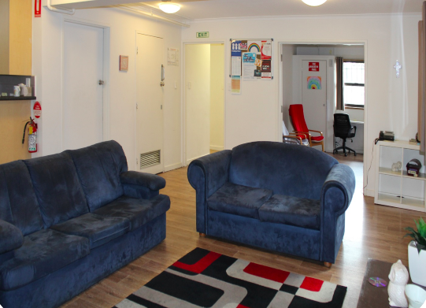
Homelessness support services linked to accommodation
    Crisis supported accommodation (CSAs): 423 beds in Victoria: youth refuges, women’s refuges and supported accommodation for single men, single women and families.
    Case managed support in crisis support and crisis supported accommodation services is funded for an average of six weeks with a higher ratio of staff to clients (generally 1 worker: 6 individual clients or 5.5 households when assisting families).
    Homes First: Replaces Homelessness to a Home and Homes for Families which linked housing and support packages for 18 months for people with a history of sleeping rough, who were accommodated in hotels during lock down. (Not taking new clients.)
    Foyer models: Step Ahead, Ladder, Hope Street Melton and Whittlesea, Launch Broadmeadows and soon Wyndham
    Transitional housing: all tenants of transitional housing must have a homelessness or other support worker
Notes:
Amy
Many people think we are a housing system, but we have very little housing - most of the resources of the homelessness system are support servicess.
These are the few models that are attached to housing. We do not have any long term housing in the homelessness system.

Slide 38
Homelessness (transition) support
(Activity 20082)
Outreach based case managed support to assist people in crisis to move to independent long term housing.
The average duration of support is 13 weeks.
Generally provided on an outreach basis:
clients may be residing in temporary situations (e.g. a rooming house), exiting crisis accommodation (e.g. refuge),
or in transitional housing. Support may be offered from an office base, the client’s residence or an agreed venue
1 worker: 12 clients when supporting individuals
1 worker: 7.5 households when assisting families (about 2.5/hrs a week per client)
Support provision includes:
assistance to find housing, emotional support, advocacy, assistance to obtain income, parenting support, active referral to other service systems, assistance with living skills, assistance to access employment, education and
training.
Notes:
Sarah
The majority of homelessness services are funded as transition support services – outreach based, case management support services. We are funded to support consumers, wherever they are staying.
Each funded model comes with a target. This target is an average, not a prescription, to guide services in planning their responses.
Homelessness support is very holistic – we are funded not only to help people access housing, but also to address any issues that have contributed to them becoming homeless or that will impact how stable future housing is.

Slide 39

Transitional Housing Management (THM) Program
Transitional properties are either owned or leased by the Director of Housing
The purpose of the program is to provide short term accommodation while a household stabilises.
Salvation Army Housing Services and Unison manage 500 THM properties in the West.
IAP refer into THM properties from the prioritisation list.
A tenant must have a support worker throughout their tenancy.
A Housing and Support Partnership Agreement guides responsibilities of tenancy admin, support and the tenant.
Tenancy conditions are determined by the RTA.
Notes:
Sarah
The Transitional Housing Management Program is the main source of housing for the homelessness sector. Transitional housing is medium term housing and is subject to the Residential Tenancies Act.
Properties are managed by a Transitional Housing Management Program. In the West there are two programs, Unison and the Salvation Army Housing Service, managing 500 properties.
IAP refer people into transitional housing from the prioritisation list.
A transitional housing tenant must already have a support worker, who can support them throughout their tenancy.
We have a Housing and Support Partnership Agreement, which outlines the responsibilities of the tenant, support worker and tenancy worker.

Slide 40

Brokerage
Housing Establishment Fund:
  Initially to assist households to maintain or establish housing.
  Access point services use to purchase emergency accommodation.
  Support services to assist consumers to settle into new housing.
Private Rental Access Program (PRAP):
  Managed by access point services
  DFFH program guidelines: PRAP Guidelines revised 2019.pdf (dffh.vic.gov.au)
  Includes three elements: Private rental brokers, Private rental assistance brokerage & PRAP Plus (support program)
  Up to $7,000 brokerage packages available per household once every 12 months (DFFH can approve higher amounts)
Family Violence Flexible Funding Packages:
  Provide a new individualised approach to respond to victim/survivors experiencing family violence. Individualised packages of up to $10,000 will be available, with an average cost of $3,000. DFFH program guidelines here
  Managed by GenWest in the West; available through The Orange Doors: Brokerage services | Family violence information for professionals | What We Do | GenWest | Gender Justice and Change | Genwest
Children’s Resource Program brokerage: http://merri.org.au/site/regional-childrens-resource-program/
Creating Connections Education Employment Pathways (CEEP) brokerage:
https://www.mcm.org.au/homelessness/support-services/ongoing/creating-connections-ceep
FRMP brokerage: https://www.mcm.org.au/homelessness/frontyard/our-services/family-support/family-reconciliation-mediation-program
Youth Private Rental Brokerage: https://vincentcare.org.au/our-services/private-rental-brokerage-program/
Notes:
Marcella/Amy
There are a number of brokerage programs that you can assist clients to access. These brokerage options are hyperlinked so that you can find out more about them.
PRAP can be accessed through the access points…

Slide 41

Family Violence Services in the West
Homelessness funded family violence programs:
    Family Violence Outreach Support/L17s
    Court Support
    CALD specific support
    Flexible funding packages
  Women’s refuges
  Elizabeth Morgan, Women’s Health West, McAuley Community Services for Women & Safe Futures
  Statewide: Safe Steps and In Touch
  Broader Integrated Family Violence Services:
  The Orange Doors
    Men’s behavioural change programs
    Women’s and children’s counselling programs
    See also The Rainbow Door
Orange Doors are now operating in the West
A new Family Violence Court is opening in Sunshine
You can access information about family violence responses in the West here: WIFVC - Western Integrated Family Violence Committee
Notes:
Sarah
Most family violence services are homelessness funded because the initial Act of Parliament, that established the homelessness sector, identified that anyone who is not living in a safe home is experiencing homelessness.
The Orange Doors have just recently opened in the West.
Elizabeth Morgan House Aboriginal Women’s Service now has office in the West

Slide 42
Resources for young people
Family Reconciliation Mediation Program:
Brokerage to assist young people to access therapies (counselling, mediation, group work) and some funding for young people couch surfing
Creating Connections:
A living skills, education, employment and training program (including CEEP brokerage) – managed by Melbourne City Mission and a Private Rental Brokerage program managed by VincentCare
Homelessness Youth Dual Diagnosis Initiative (HYDDI) – based at WRAP, this position provides secondary consultation for workers supporting people with both mental health and substance use issues.
Youth Reconciliation positions
YAC and SAFY
Youth Allocations Committee (YAC) and Supported Accommodation for Young People (SAFY) – assisting all young people who present to the HSS in the West
Notes:
Sarah
Youth Working Group

Slide 43
ACCOs in the North and West
First Nations people have the option of presenting to the generalist services or to one of the Aboriginal Community Controlled Organisations operating across the North & West:
Aboriginal and Torres Strait Islander access points will be opening.
Elizabeth Morgan House Aboriginal Women’s Service: support for Aboriginal women or other women involved with Aboriginal men experiencing family violence, Ph: (03) 9482 5744. Has an office in Melton. www.emhaws.org.au
Marg Tucker Hostel for Girls: accommodation service for young women; Fairfield, Ph: (03) 9482 1161, margarettucker.org.au
Bert Williams Aboriginal Youth Service: crisis accommodation service for young men;
VACSAL – homelessness outreach program
Case management service for Indigenous men who use violence, Thornbury, Ph: (03) 9484 5310, www.vacsal.org.au/programs/bert-williams-center.aspx
WT Onus and George Wright Shelter for the Homeless – Aboriginal Hostels Ltd: Northcote, Ph: (03) 9489 6701, www.ahl.gov.au (ring first to check that the service is taking referrals)
Indigenous Tenancies at Risk program: based at Aborigines Advancement League; Thornbury, Ph: (03) 9480 7777
VACCA – support to families experiencing homelessness – operating in Werribee
Salvation Army has an ATSI IAP worker, who will be based at Kirrip four days a week and at the Sunshine office one day a week. Kirrip provide cultural supervision.
Notes:
Sarah
There are only two homelessness funded Aboriginal Community Controlled Organisations operating in the West: VACCA and Elizabeth Morgan House Aboriginal Women’s Service, which has a new office in the West.
Recently the Salvation Army has established an outposted IAP response at Kirrip.
ACCOs in the North have said that Western services can contact them for secondary consultation and referral.

Slide 44
Other direct referral services
    Youth programs:
    Reconnect
    Program for 12 -18 years who are homelessness or at risk
    Hope to Home Whittlesea
    A program, managed by Hope Street, to assist young people to access private rental
    Melton First Response Youth Outreach: outreach based support for young people in Melton
    Supported referral services
    Some homelessness funded youth services provide an assertive outreach role – supporting young people until they are ready to contact an access point service.
    You can contact these services directly:
    Flat Out/ACSO/Brosnan
    Support services for adult men, adult women and young people in contact with the criminal justice system
    Day centres
    Provide meals, showers, some onsite services
    Bright Futures North West
    Support for children and secondary consultation on supporting children
    Greenlight Partnership
    Support to people who were sleeping rough but who have now access housing with links to Yarra, Melbourne and Stonnington
    Pride In Place
    Pride in Place assists lesbian, gay, bisexual, trans and gender diverse, intersex, asexual and queer people find housing in the Inner West, Hume, Merri-bek, Outer East and Central Highlands.
Notes:
Sarah
Most homelessness services are accessed through an access point.
There are some specialist services that you can refer directly to. These organisations they are generally statewide, one of a kind or capacity building services

Slide 45
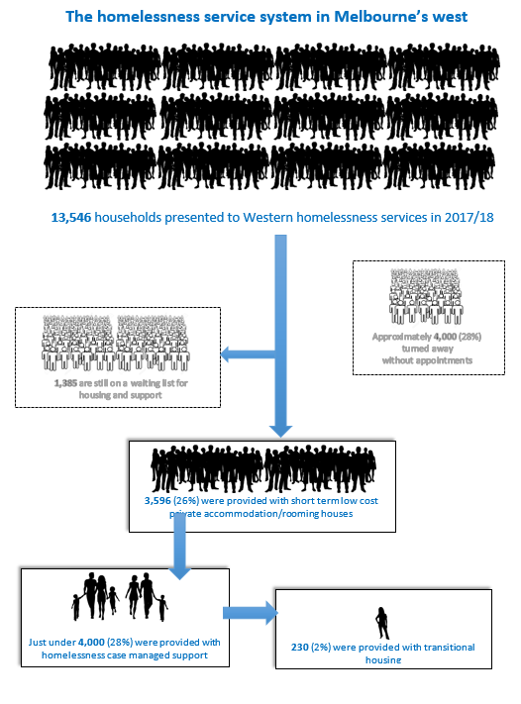
Homeless Service System: need vs capacity
Notes:
Sarah
This picture shows the difference between the number of people presenting to the service system and the numbers that the homelessness system can assist.
Highlight this so workers and consumers have a realistic understanding of the service system
Information about services?
How do you feel about the data provided?

Slide 46



Be kind…
Notes:
Amy
Everyone is doing their best in a very demanding and challenging environment. We are part of one big team with shared resources for shared clients.
No-one owns the client – they are a client of the whole system, at the centre of the system – we are working together to support them, guided by the client.
Check first why someone is responding as they are – before assuming they are wrong. Provide feedback kindly/constructively.
Be mindful about the pressure workers are under, particularly at the access points. Get information about the level of demand vs resources so that you can provide your clients with realistic information.
Where possible, make contact with a worker first by email or phone – secondary consultation.

Slide 47
Role of the homelessness service system
30,605
Notes:
Sarah
We will now look briefly at the funding for, and role of, the homelessness system.

Slide 48

Aim of the HSS
To provide assistance to people who are homeless or at risk of homelessness to support them:
  to find or maintain stable long term housing; and
  to address those issues that have contributed to homelessness, or risk of homelessness, to reduce the likelihood of recurring homelessness.
Notes:
Sarah
Originally funded as a service system for people who ‘fall through the cracks’ of other systems
Our role is broad: to assist people to maintain or find housing but also to assist with any issues jeopardising the stability of a consumer’s housing

Slide 49
Funding for the HSS
Specialist Homelessness Services (SHSs) across Australia are jointly funded through by the Commonwealth and State Governments, through the National Agreement on Social Housing and Homelessness (NASHH), which operates for five years from 2024: National Agreement on Social Housing and Homelessness | Department of Social Services, Australian Government (dss.gov.au)
The Commonwealth sets targets for the State, but the State manages allocation of the funding.
Funding is allocated to community organisations through a Funding and Service Agreement (FASA) by the Department of Families, Fairness and Housing.
The FASA outlines targets for each homelessness program and all guidelines, legislation and conditions of funding that the service must adhere to. https://fac.dhhs.vic.gov.au/
Notes:
Sarah
We are funded as Specialist Homelessness Services and often refer to ourselves as the Homelessness Service System (HSS)
SHSs are jointly funded by the State and Federal Governments through the National Housing and Homelessness Agreement.
Victoria has signed the bi-lateral agreement between the Victorian and Federal Governments under this Agreement.
Agencies can find FASA information on the Funded Agency Channel.
The FASA sets a target for the number of people each program should work with each year.

Slide 50
Framework for the homelessness service system
30,605
Notes:
Sarah
The Government funds homelessness services in Victoria to work in specific ways. We will quickly look at that approach now.

Slide 51
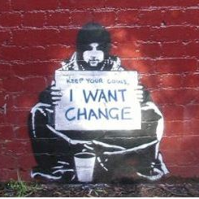
Practice Framework
Services are funded to work from an approach which is:
Strengths based
Consumer focussed
Trauma informed
Children are consumers
Case managed (in the support services)
And to work with these Family Safety Victoria Frameworks:
Responsive to family violence (MARAM)
CISS/FVISS
Child Safe Standards
Notes:
Sarah
We have outlined some of the practice approaches that make a good homelessness worker. These stem from the approaches outlined in our funding agreement.
Homelessness services are required to see children as consumers in their own right, with individual support plans.
We are also funded to participate in the Family Violence Family Violence Multi-Agency Risk Assessment and Management (MARAM) Framework
and in new
information sharing legislation: the Child Information Sharing Scheme (CISS) and the Family Violence Information Sharing Scheme (FVISS), visit the Information sharing guides, templates and tools page

Slide 52
Elements of good homelessness practice
Tenacity and consistency: do what you promise to do
Attentiveness: consumers are the experts in their own lives
Consumer focused: what are the consumer’s priorities?
Trauma informed: know the impacts of trauma; operate in a trauma informed way
Strengths based: consumers show enormous strength by surviving homelessness – let them know that and draw on their strengths/resources
Flexible – ask consumers how they would like to communicate (face to face, text, email, What's app, zoom)
Honest – only offer what you can. Provide clear and transparent information.
Notes:
Amy
Each consumer is an individual, who will have their own needs and concerns.
Many people become homeless as the result of a trauma and the experience of homelessness is definitely traumatising, so it is extremely important that homelessness workers understand the impact of trauma and work in trauma informed ways.
We are funded to work from a strengths base – acknowledging the enormous strengths that consumers have in surviving the experience of homelessness and encouraging them to identify their needs, drive their support plan and supporting them to take control of their lives.
Don’t underestimate the impact of providing food and some emergency relief. These are signs of caring and support.
Be flexible in how you provide services – people have varied preferences for communication and support.

Slide 53
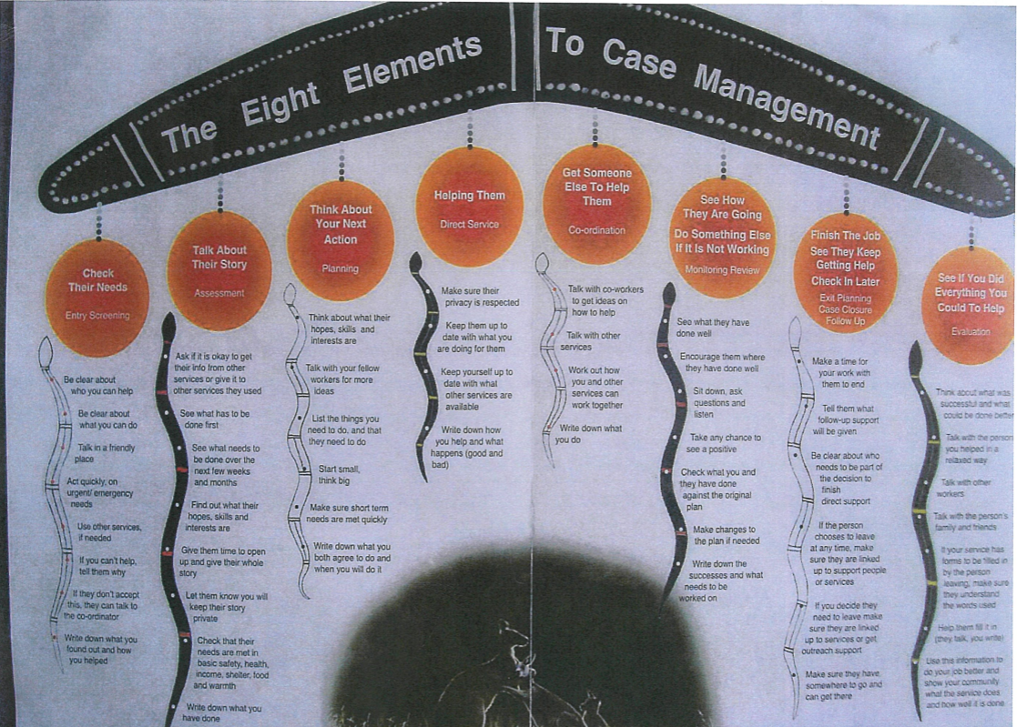
Case Management Framework
Notes:
Sarah
Services work to an 8 step case management framework.
The SAAP Case Management Guide can be found on the NWHN website.

Slide 54
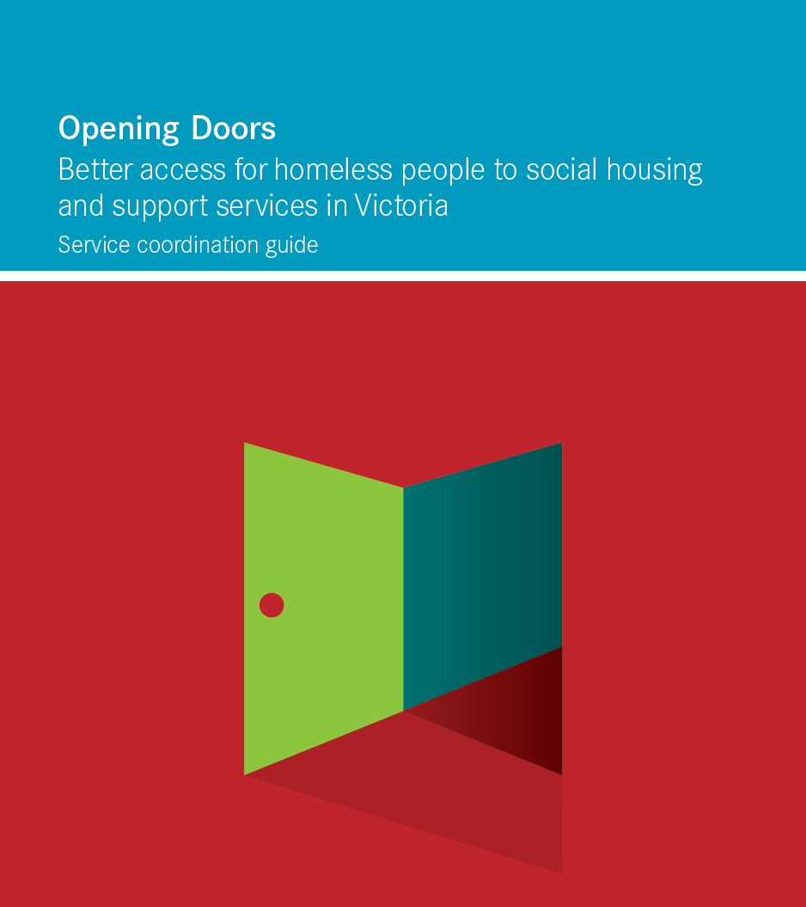
Role of the LASN
Homelessness services were formed into local area service networks (LASNs) with shared responsibility for:
Holding consumers and assisting them to navigate the service system
Coordinated provision of services
Operating a shared prioritisation approach matching client need to available resources
Managing the limited resources of the Sector effectively
Sharing information and provide advice to DFFH & advocacy
Authorised delegate attends LASN meetings
LASN agencies abide by LASN decisions
Notes:
Sarah
The Opening Doors Framework introduced a coordinated homelessness system and establishment of LASNs, a shared mechanism to resolve issues, including those stemming from very limited resources.
All homelessness services are required to participate in LASNs and to adhere to LASN decisions.
The LASN meets every six weeks and every homelessness funded agency has one vote on LASN decisions.

Slide 55

Shared approaches
Common approaches and shared tools:
A shared assessment framework
A shared approach to prioritisation
Development of a vacancy management system
Statewide and local practice guidelines
Ereferral
The LASNs monitor arrangements through:
Regular LASN meetings
Improvement processes
Consumer feedback
Working Groups
Notes:
Sarah
It also brought a sense of shared responsibility for clients in all parts of their service system and a much greater capacity to coordinate the different elements of the service system.
Read the Opening Doors Framework.
We will now move on to a break and then come back to discuss how to navigate the homelessness system.

Slide 56
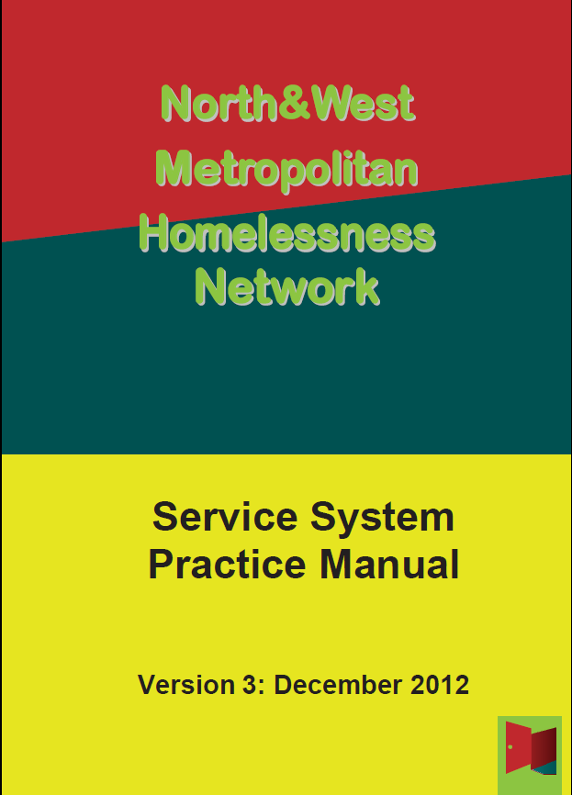
Guidelines
Statewide
Statewide resources (nwhn.net.au)
Homelessness Guidelines and Conditions of Funding, May 2014 + 2020 updates – about to be updated.
Opening Doors Framework
Prison Exits Protocol – to be incorporated into updated Guidelines.
Cross Regional Referral Protocol – to be incorporated into updated Guidelines.
Youth Justice/Homelessness Protocol – to be incorporated into updated Guidelines.
Private Rental Access Program (PRAP) Guidelines
MARAM Guidelines
H2H Guidelines
Aboriginal Cultural Safety Framework
Homelessness/NDIS guidelines
In the West
Northern and Western Homelessness Guidelines (nwhn.net.au)
Regional Practice Manual – currently being updated
LASN Terms of Reference
Housing and Support Partnership Agreement – currently being updated
Family Violence Entry Point/ Homelessness Access Point Protocol – currently being updated
IR 2 Practice Guide
Post Referral Feedback form
Intra regional HEF Guideline/Access Coordination Practice
Notes:
Sarah
There are a range of Guidelines outlining how homelessness services should operate. These Guidelines can be found on the NWHN website. Some apply to the whole State and some are local, or shared with the Northern region.

Slide 57
Peak bodies, training and consumer advocacy
There are three peak bodies particularly relevant to homelessness and family violence services:
Council to Homeless Persons (CHP)
Community Housing Industry Association (CHIA Vic)
Safe and Equal (formerly DV Vic)
Sign up to CHP ebulletin:
https://chp.org.au/enewsletters/
HAS is the key advocacy service for consumers who are homeless or at risk of experiencing homelessness.
HAS can assist consumers to address issues with services.
The goal of HAS is to achieve mutually beneficial resolutions for consumers and service providers.
Angela Kyriakopoulos is the HAS Advocate. You can contact Angela via email at angela@chp.org.au or by phone on 1800 066 256 or 9415 6200; please ask for HAS.
Peak bodies
Homelessness Advocacy Service
Training
Sign up to CHP Learning Hub: https://chp.kineoportal.com.au
Notes:
Amy
PEAK BODIES
There are three peak bodies particularly relevant to homelessness and family violence services:
Council to Homeless Persons (CHP)
Community Housing Industry Association (CHIA)Vic
Safe and Equal (formerly DV Vic)
You can sign up to CHP ebulletin: https://chp.org.au/enewsletters/ and to the CHP Learning Hub, which provides free and low cost online and face to face training for homelessness workers and students: https://chp.kineoportal.com.au
HOMELESS ADVOCACY SERVICE
HAS is the key advocacy service for consumers who are homeless or at risk of experiencing homelessness.
HAS can assist consumers to address issues with services.
The goal of HAS is to achieve mutually beneficial resolutions for consumers and service providers.
Angela Kyriakopoulos is the HAS Advocate. You can contact Angela via email at angela@chp.org.au or by phone on 1800 066 256 or 9415 6200; please ask for HAS.

Slide 58
Long term housing
30,605
Notes:
Sarah
We will now look briefly at the funding for, and role of, the homelessness system.

Slide 59
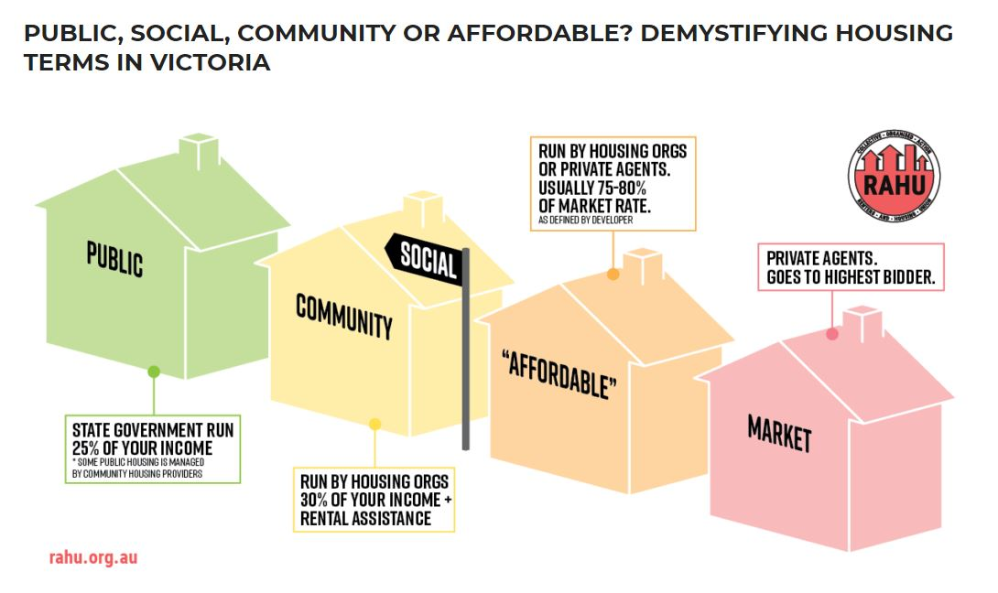
Long term housing
What is social housing?
Social housing is an umbrella term to describe short and long-term rental housing that is owned and run by the government or not-for-profit agencies. ... It is for people on low incomes who need housing, especially those who have recently experienced homelessness, family violence or have other special needs.
Generally housing is referred to as public housing if it is managed by Homes Victoria, Department of Families, Fairness and Housing.
Housing managed by not for profit non government Housing Associations is generally referred to as community housing.
Notes:
Amy
Social housing is an umbrella term to cover ‘pubic housing’, which is funded and managed by Homes Victoria and ‘community housing’ which is managed by not for profit housing managers. Many of these properties are funded by Government.
There are some differences in operation:
Public housing rent is 25% of income
Social housing rent is 30% of income but most tenants also access Commonwealth Rent Assistance.
All public housing and most community housing tenants are drawn from the Victorian Housing Register.

Slide 60
Victorian Housing Register
The Victorian Housing Register is a single register, managed by Homes Victoria, for applications for both public housing and community housing. (https://www.housing.vic.gov.au/victorian-housing-register)
Homelessness agencies have access to an EPRIN number, which enables support workers to submit housing applications on behalf of consumers through a portal.
Community housing providers are able to opt-in to the Register and select the amount of stock they wish to allocate through the Register.
The VHR has two main categories, Register of Interest and Priority Access. Register of Interest is for all eligible applicants to register their interest in social housing.
Priority Access is for people:
  Who are homeless* and receiving support
  Are escaping or have escaped family violence
  With a disability or significant support needs
  With special housing needs
  Over 55
*Homelessness is broader than people sleeping rough and covers crisis and transitional housing, unsuitable or substandard housing, couchsurfing, squatting and some other circumstances.
Notes:
Amy
Many community agencies have applied for an ‘EPRIN’ number, which identifies that the agency has been endorsed to make recommendations about people who should be considered for ‘Housing with support’.
Applications are processed faster if a worker/consumer submits it online through MyGov or through the worker portal. There have been delays recently in processing applications.
It is worth encouraging consumers to tick both ‘public housing’ and ‘community housing’ when they put in a VHR application.
It is also useful for consumers to list several broadband areas.
The public housing guidelines are on the Homes Victoria website and housing decisions can be appealed through the Housing Appeals Office.
Through COVID the Emergency Management Category has been established – primarily for H2H clients and those who are sleeping rough.

Slide 61
 | Application Category | Description | New or Transfer applications
Priority | 1. Emergency management | For people whose housing is no longer safe or habitable, due to an emergency, e.g., a bushfire, flood or storm |  | Transfer or new applications
 | 2. Priority transfers | For existing public or community housing tenants who require relocation due to the current property being unsafe or unsuitable, or is to be redeveloped, sold or could be better utilised. |  | Transfer applications only.
 | 3. Homeless with support | People who are homeless and receiving support. Applications are lodged by support workers. |  | New applications only.
 | 4. Supported housing | For households who need a home with major disability modifications, or that receive independent living assistance or care. |  | New applications and transfer applications for reasons of ‘severe overcrowding’ and ‘urgent medical needs’.
 | 5. Special Housing Needs | The special housing needs category helps individuals or families whose housing becomes unsuitable or who have no other housing options. Reasons applicants might apply under this category include insecure housing, inappropriate housing, unsafe housing and urgent medical need. |  | New applications only.
 | 6. Special Housing Needs, Aged 55 and over | For singles or couple aged 55 years or over who are not eligible for other priority access categories. |  | New applications only.
Register of Interest | For all other applicants who meet the general eligibility criteria for the VHN but do not satisfy the additional priority criteria. |  |  | Transfer or New applications.
Notes:
Marcella/Amy
This slide outlines the categories in the Victorian Housing Register. Homelessness agencies can recommend people for the ‘Homeless with Support’ category.
Consumers can submit ‘Special Accommodation Requirement’, called SARS applications rqeuesting special conditions on housing, but, the more SARS on an application, the lower the likelihood of a housing allocation.
People in community housing managed rooming houses are now considered to be in social housing. If they want to access public housing or community housing, they can apply for a VHR transfer.
Even though wait times for social housing are long, it is still worth assisting consumers to put in applications. We don’t know where they will be by the time an offer is made and it is important that the Government knows how many people are waiting for housing.

Slide 62
Whilst the number of people awaiting social housing in Brimbank/Melton does not fall far short of those from Western Metro, the level of current stock is far lower.
More information about social housing can be found at: www.housing.vic.gov.au
You can appeal a social housing decision here:
Appeal a decision | Housing.vic.gov.au
You can find out about the number of current applications by broadband here:
Victorian Housing Register and transfer list by local area – June 2021.xlsx (live.com)
Current social housing stock vs applications:
Melbourne's west
Notes:
Sarah

Slide 63
Big Housing Build
State Government has allocated $5.3b to build more social and affordable housing in Victoria.
Big Housing Build projects in the West:
Affordable housing:
Government has built some ‘affordable’ housing for people on middle incomes. Rental agreements generally for 3 years with rent lower than market rent. Sign up for updates:
Homes Victoria Affordable Housing Scheme (HOMES) affordable@homes.vic.gov.au or Homes Victoria affordable | Homes Victoria
LGA | # of projects | # of homes | # underway | # completed
Brimbank | 23 | 287 | 242 | 35
Hobsons Bay | 8 | 34 | 30 | 4
Maribyrnong | 35 | 322 | 180 | 142
Melbourne | 12 | 1713 | 571 | 1,142
Melton | 15 | 63 | 34 | 29
Moonee Valley | 7 | 583 | 180 | 142
Wyndham | 51 | 339 | 302 | 37
West total | 151 | 3341 | 1539 | 1531
Notes:
Sarah
Applications are processed faster if a worker/consumer submits it online through MyGov or through the worker portal.
It is worth encouraging consumers to tick both ‘public housing’ and ‘community housing’ when they put in a VHR application.
It is also useful for consumers to list several broadband areas.
Consumers can submit ‘Special Accommodation Requirement’ applications but, the more SARS on an application, the lower the likelihood of a housing allocation.
People in community housing managed rooming houses are now considered to be in social housing. If they want to access public housing or community housing, they can apply for a VHR transfer.
The public housing guidelines are on the Homes Victoria website.
Through COVID the Emergency Management Category has been established – primarily for H2H clients and those who are sleeping rough.
We are delivering 2,400 affordable rental homes in response to the growing gap in housing affordability as part of the landmark $5.3 billion Big Housing Build.
Homes Victoria affordable is a unique alternative to the private rental market to help low to moderate income Victorian renters get access to high quality and secure housing at an affordable rent.
Under the program, rents in metropolitan Melbourne are set at least 10 per cent below the area’s median market rent, with the added protection of a cap set at 30 per cent of the median income.
Fixed-term rental agreements of three years ensure that all homes start affordable and stay affordable.
Homes are located close to shops, transport and workplaces, with locations across Victoria. When applying, please note that homes do not currently qualify for Commonwealth Rent Assistance under the current Commonwealth Government policy.

Slide 64
Private Rental Access Program (PRAP)/
Private Rental Brokerage (PRB)
Rent in advance
Available through the access points
Rent will be no more than 55% of income
Required documents – acceptance email from Real Estate Agent or private landlord
Correspondence indicating that income and rental affordability is calculated @ 55% of income
IAP can request up to three weeks rent in advance from PRAP
Rental arrears
Notice to vacate from VCAT
Current income statement
Income and rental affordability is calculated at 55% of income
Contact may be made with Real Estate or landlord to discuss payment plan to save tenancy
Bonds
Can be access through Homes Victoria: RentAssist bond loan | Housing.vic.gov.au
Notes:
Marcella/Amy

Slide 65
Resources for applying for private rental
Realestate.com.au
Fairy Floss Real Estate Facebook group - 236,000+ members, and specific to Melbourne. Main focus is ads for rooms in share houses. Fairy Floss Real Estate - Posts | Facebook
Flatmates.com.au (Listings for rooms in Melbourne)
https://www.domain.com.au/
https://www.gumtree.com.au/s-flatshare-houseshare/melbourne/
Flatmatefinders.com.au
Dept of Social Services website for information on National Rental Affordability Scheme (NRAS) properties for rent
Queer Housing Melbourne & Trans Housing Melbourne Facebook groups
Gayshare: Gay Share Flatmate Service - Home | Facebook
Tenant’s Victoria inspection checklist
Affordable housing register
Notes:
Marcella/Amy

Slide 66
Tenancy Support
Tenants Victoria (general advice line, workers’ advice line, rooming house support line)
Justice Connect Homeless Law
Consumer Affairs Victoria
Tenancy Assistance and Advocacy Programs – for private rental only, including private rooming houses and caravan parks. Uniting Lentara runs the program for Brimbank, Melton, Hume, Moreland and the North East. WestJustice runs the program for Melbourne, Maribyrnong, Moonee Valley, Hobson’s Bay and Wyndham.
PRAP Plus programs
International Students' Housing and Accommodation Legal Service (via Study Melbourne and WEstJustice)
Tenancy Plus: Tenancy support for people in public and community housing: Tenancy Plus support program | Housing.vic.gov.au
https://www.housing.vic.gov.au/private-rental
Notes:
Marcella/Amy
Changes to the RTA – very helpful to check with Tenants Victoria

Slide 67

Non homelessness resources
Information:
Facebook group: Melbourne Homelessness Support Group
Emergency relief list from DFFH western-region-emergency-relief-services-covid-19-update-19-october-2021.pdf (nwhn.net.au)
Ask Izzy – website providing information about local community services; not great on homelessness services
Making Links: AOD, Mental Health pathways Making Link: AOD, Mental Health and Homelessness Partnership in Melbourne's north and west (nwhn.net.au)
NWHN Website: reports from info sessions on NDIS, Births, Deaths, Marriages WHN Info sheets (nwhn.net.au)
Legal assistance: WestJustice, Youth Law, Youth Justice
Telstra – free phone boxes (SHIP: credit on phones)
Financial support: No Interest Loans Scheme (NILS - No-interest Loan Scheme - DFFH Services), Queens Fund, Energy payment
NDIS – Brotherhood of St Laurence is local NDIS provider
Notes:
Amy
Tips for SHIP Credit - $40 top ups for Telstra customers through SHIP
People experiencing homelessness do not have to pay public transport fines or failure to vote fines.
Don’t type any spaces into the phone number.
When putting the phone number in the ‘contacts’ section, the option will come up for Telstra phone users.
All pre-existing credit is lost so wait to top up when the client has not credit. Credit is applied within half an hour.

Slide 68

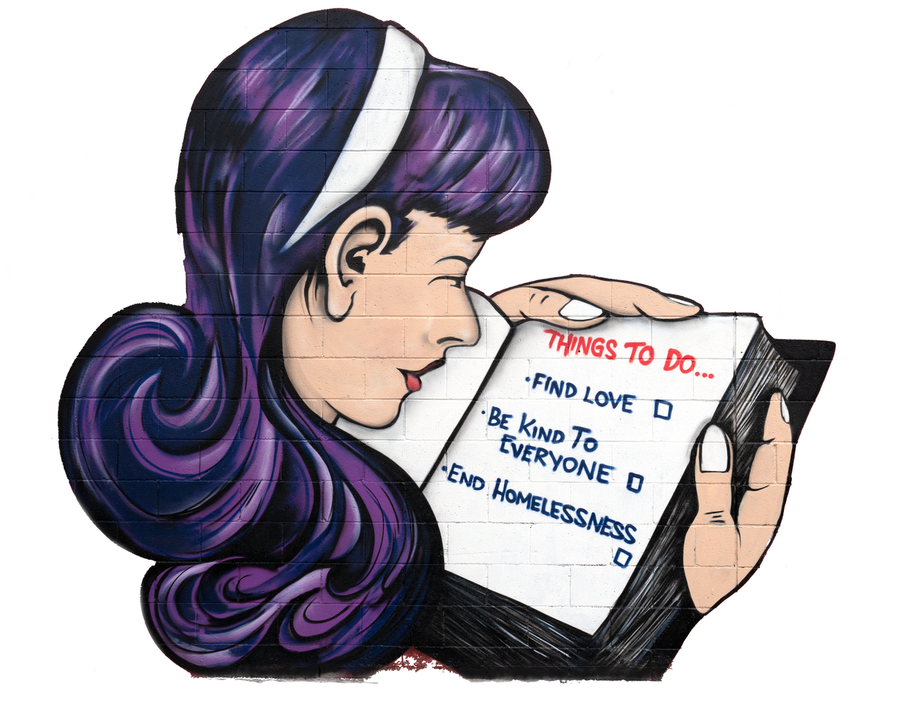
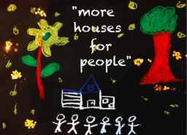
Advocacy
Notes:
Sarah
A key role for homelessness services is to advocate for people experiencing homelessness. Each year the Northern and Western Homelessness Networks undertake a consumer survey. The responses to this survey inform our advocacy work.

Slide 69

What will reduce homelessness in Melbourne?
Houses, houses, houses……
Notes:
Sarah
So, what do we advocate for?
Why are we doing the advocacy?

Slide 70
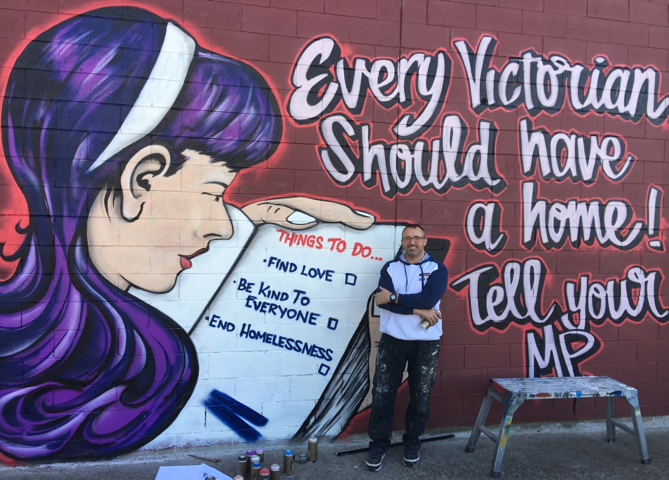
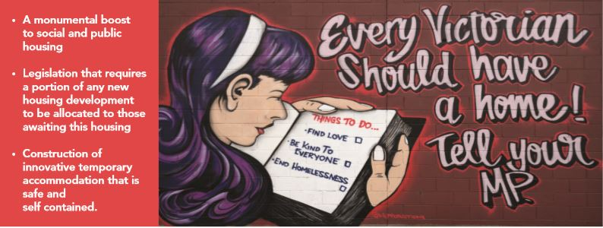
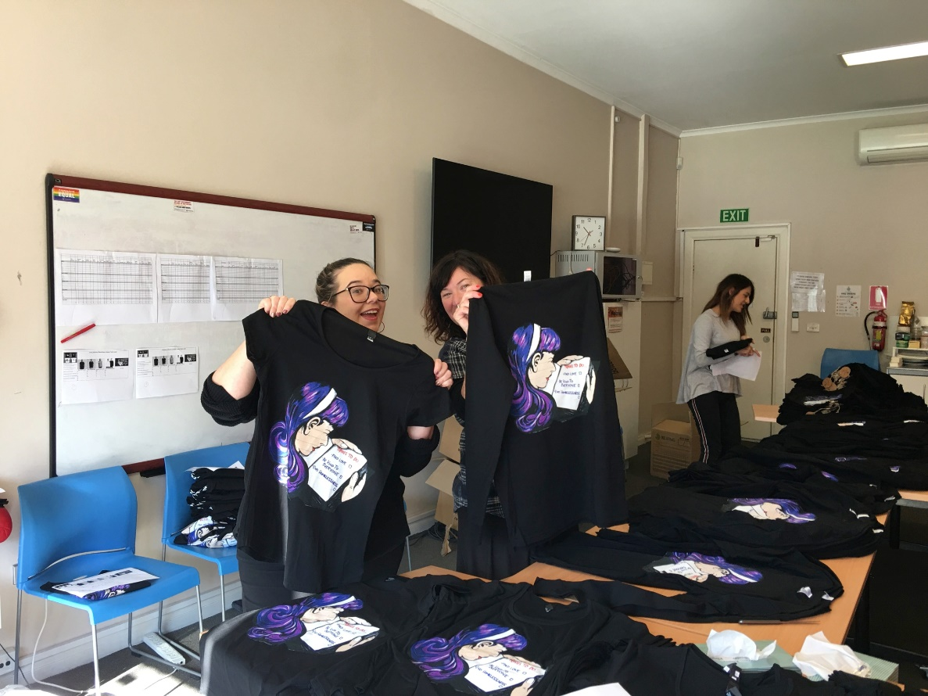
Every Victorian Should Have a Home campaign
Notes:
Sarah

Slide 71

What can you do?
Talk to your family, friends and colleagues about homelessness and the housing crisis
Ring or email your State and Federal Members of Parliament
and tell them that:
We need immediate solutions to increase our supply of affordable housing:
A monumental boost to social and public housing (building more public housing is an ideal economic stimulus activity)
Legislation that requires a portion of any new housing development to be allocated to those awaiting this housing
Construction of innovative temporary accommodation that is safe and self contained.
Build Origami Houses for Homelessness Week
See: Houses At Parliament | Houses At Parliament (vhn.org.au)
Notes:
Sarah
So you may be wondering what you can do to reduce homelessness and address the housing crisis in Victoria.
There are a number of things that you can do.
The first is very simple. Talk with your friends, family and colleagues about the housing crisis. Raise awareness about the need to focus on building more affordable housing and creating innovative housing solutions.
You can email your local State and Federal Members of Parliament. They need to know that Victorians support:
A monumental boost to social and public housing (building more public housing is an ideal economic stimulus activity)
Legislation that requires a portion of any new housing development to be allocated to those awaiting this housing
Construction of innovative temporary accommodation that is safe and self contained.
They are more likely to direct money to these things if they know they have the support of the population. Tell them that homelessness is not good for individuals, but it is also not good for the community.

Slide 72

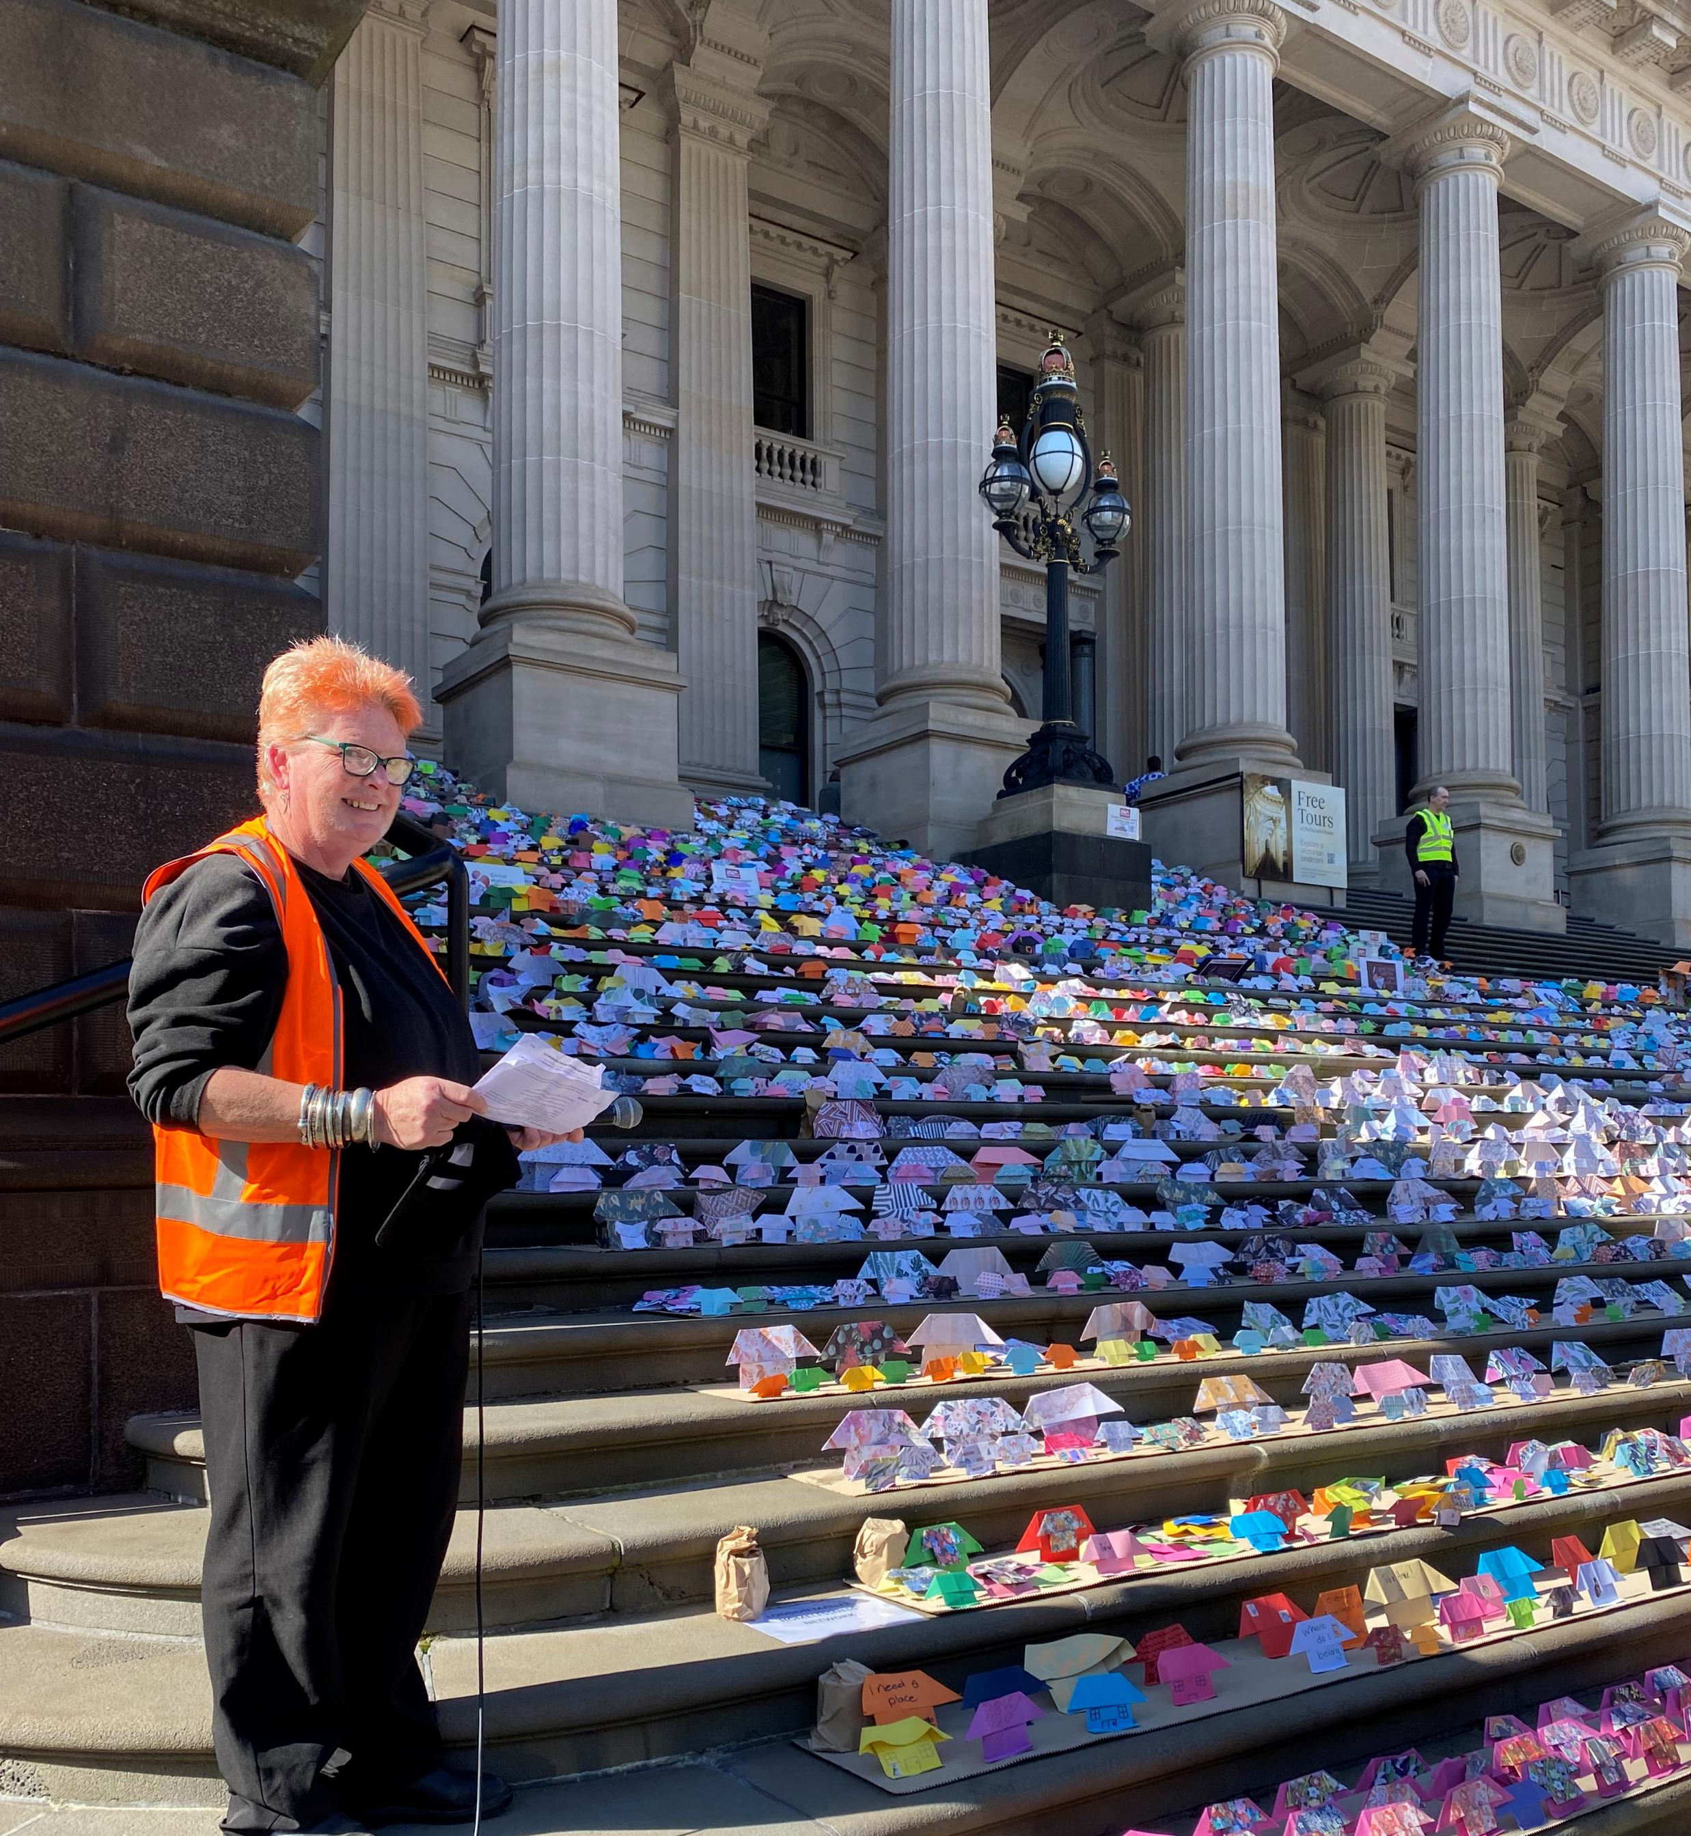
Notes:
HAP is happening again – 31st July

Slide 73

Join the Everybody’s Home campaign
Ask the Federal Government to:
■ Commit to invest in building 25,000 homes per year
■ Increase the Commonwealth Assistance rate by 50 per cent
■ Commit to a plan to end homelessness by 2035
https://everybodyshome.com.au/
Notes:
Sarah
If you would like to take more action, you can join the National Everybody’s Home campaign, which is campaigning for a national affordable housing strategy and focus on creating more affordable housing.
If you join the campaign you will receive updates and further actions that you can take.

Slide 74

For further information…
Sarah Langmore
Western Homelessness Networker
Ph: 0407 832 169
sarah@wombat.org.au
Northern & Western Homelessness Networks’ website: www.nwhn.net.au (WLASN member page password is: WLASN)
Subscribe to e bulletins: Get the latest from NWHN (confirmsubscription.com)
Link to NWHN Guidelines: Resources for homelessness workers in Melbourne's north and west (nwhn.net.au)
Link to Making Links Guide to the AOD, homelessness and mental health sectors: Making Link: AOD, Mental Health and Homelessness Partnership in Melbourne's north and west (nwhn.net.au)
Notes:
Thanks for giving us the opportunity to speak with you today. If you have any queries, please contact Sarah or Lee
Subscribe to the fortnightly bulletin.
We will send out an evaluation link. We are in the process of updating the website. There are now a series of pages with all the key documents.
We are now going to do an online activity to give you the chance to provide feedback and ask any additional questions, anonymously.

